Slide 1
ACCESS for ELLs 2.0
Federal Programs Fall Workshop
Susan Beard
Student Assessment Section

Slide 2
Ready, Set, Go…
ACCESS for ELLs 2.0(ACCESS 2.0), the new computer-based English language proficiency assessment, will be administered beginning February 1, 2016.
ACCESS 2.0 will replace the paper-based ACCESS for ELLs.
Data Recognition Corporation (DRC), the new test vendor, will replace MetriTech.
Alternate ACCESS for ELLs and the kindergarten test will remain the same and will continue to be a paper-based kit.
Notes:
Paper based kit will still be available for those students who are unable to complete the test on a computer.

Slide 3
Changes, Changes, Changes…
No Changes…
There will not be any changes to the kindergarten test or the Alternate ACCESS for ELLs test.
Computer-Based Test | Paper-Based Test
No more tiers! | Tiers A, B, and C
Multiple grades may test at the same time | Students must test by tier and grade-span
Built in accommodations and accessibility features | Enhanced graphics and new scoring scale for the Speaking test
Headsets – not headphones – are required for the computer-based Speaking test | Students will listen to a CD as the Test Administrator scores the Speaking test
Notes:
CBT is adaptive and placement in the Writing and Speaking tests will be automatically done by the program.
New Scoring Scale: No response, or Attempted, Adequate, Strong, and Exemplary – No longer: Meets, exceeds, and approaches.

Slide 4
Changes in Grade-Level Clusters…
New grade-level clusters for computer-based assessment: New grade-level clusters for paper-based assessment:
Kindergarten* Kindergarten
Grade 1 Grade 1
Grades 2-3 Grade 2
Grades 4-5 Grade 3
Grades 6-8 Grades 4-5
Grades 9-12 Grades 6-8
Grades 9-12
*Kindergarten will remain an interactive paper-based kit. In 2017 grade-level clusters for the paper-based assessment will align to the grade-level clusters on the computer-based assessment.
Notes:
In the past there were 5 grade level clusters
Now there are 7
Something to think about when deciding between paper and computer.

Slide 5
Changes in Delivery…
Order of Administration
Listening
Writing
Speaking
Reading
Computer Adaptive:
Students’ performance on the Listening and Reading tests will determine their placement for the Writing and Speaking tests.
These may be administered together (one day) or separately.
These can be administered in either order after the Listening and Reading tests.

Slide 6
Changes to the Writing Domain…
Students will have two options on the Writing domain for the computer-based test – keyboard or handwritten.
For both modes, students will listen to and read prompts online and will either keyboard or handwrite their responses in a test booklet.
Grades | Writing Test Format | Writing Response Mode
Grades 1-3 | Paper-based test only | Test booklet
Grades 4-5 | Prompts will be viewed on the computer | Keyboard or paper (optional)
Grades 6-12 | Prompts will be viewed on the computer | Keyboard (handwritten responses in a test booklet will be allowed in unusual circumstances)*
*The WIDA AMS will provide directions for ordering additional response booklets for those students who will need them.
Overage is built in so order only what you need!!!!
Notes:
With the exception of the Writing test, all items for the Listening and Reading tests are multiple choice. Students need to have basic point and click skills. Something to think about when trying to decide whether or not to do computer based or paper based.
Those of you who may be involved with ordering: Alabama defaults to the paper-based test, so there will be plenty of Writing test booklets sent and overage is built in. Order only what you need.

Slide 7
Changes to the Speaking Domain (paper-based test)
The Speaking test will now be delivered using a CD
(this is also the same delivery as the Listening test).
The Test Administrator will still score the Speaking test.
The Speaking scoring scale has changed; therefore, training is required!!!

Slide 8
What Devices are Allowed?
IPad
Mac Book
Chrome Book
Lap top
Headset specifications can be found on the WIDA website:
https://www.wida.us/assessment/ACCESS%202.0/documents/Headset-specifications.pdf
Support System Requirements:
https://www.wida.us/assessment/ACCESS%202.0/documents/DRC%20INSIGHT%20System%20Requirements_Fall%202015.pdf

Slide 9
Test Administrator Training…
Anyone who will administer the computer-based test for Grades 1-12 is required to complete the online training.
Significant changes have been made to the paper-based test, so training will also be required.
Online training will be available on the WIDA website beginning September 4th for both the paper-based and online tests. Make sure everyone has created an online account.
Training is done by following and completing checklists.
Teachers who are administering the Kindergarten or Alternate ACCESS for ELLs test and have already completed and passed the online training do not have to retrain.
Users who do not already have a WIDA account must log into the Account Creator at www.wida.us to create their own credentials using the username: alabama and the password: pinetree
Notes:
Not everything is available now that is indicated on the checklists. WIDA will inform me when new items become available and I will let STCs know. Go ahead and begin working through the checklists.

Slide 10
How Does Online Training Work???
1.) All Test Administrators must have a username and password to access the online training at www.wida.us.
2.) Online training for kindergarten and Alternate ACCESS for ELLs will be done the same way as in the past and will result in a quiz that must
be passed with an 80% or higher. The Speaking test for paper-based testing will require passing the quiz with an 80% or higher.
3.) Training for the paper-based and computer-based tests will be conducted through the use of checklists which will help users stay on top of
everything they need to be doing for training purposes. Check marks will be placed beside boxes to indicate completion of a task. There will
be no quizzes to complete (with the exception of Speaking for paper-based testing) but there are many requirements that must be met,
including watching videos, reading materials, and listening to webinars (all are recorded).
4.) Training for WIDA AMS will be available through the online training process, but access to the actual portal will not be available until the
file that was submitted to DRC is finalized. Approximately 10 days after it is finalized, System Test Coordinators will receive and email with
set up instructions and they will then be able to grant permissions to everyone involved in the testing process. At this point, EL
Coordinators, Technology Coordinators, and Test Administrators will have access to WIDA AMS.
Notes:
Each time a task is completed on the checklist you will check the box. When all are checked System Test Coordinators will receive an email alerting them that someone has completed online training. No more certificates, although WIDA is still thinking over this so it may change.

Slide 11
Training for Online Portal - available September 4th
WIDA Assessment Management System (WIDA AMS)
View training materials
Access user guides or software downloads
Create test sessions
Add and edit students for test sessions
Print test tickets
Monitor student progress during testing
View and print reports
Order paper materials
Notes:
One stop shop where everything will be done.
Again, No one will be able to access the actual portal until DRC sends STCs an email with set up instructions.

Slide 12
Training for the Computer-Based Test – available September 4th
Technology Coordinators
Test Administrators
System Test Coordinators
Training materials on WIDA AMS/training on the WIDA website
Training modules on the WIDA website
Training modules on the WIDA website
Training Course/Checklist
Training Course/Checklist
Training Course/Checklist

Slide 13
Training for the paper-based test – available September 4th
Test Administrators Grades 1-12
Test Administrators for Kindergarten
Test Administrators for Alternate ACCESS for ELLs
Online Training on WIDA Website
Online Training on WIDA Website
Online Training on WIDA Website
Quiz/Certificate
Quiz/Certificate
Quiz/Certificate
The scoring module for the Speaking test will not be available until October 5th .
Notes:
Training modules have been enhanced.
More videos and sound bytes.
Remember: Kindergarten and Alternate have not changed and retraining is not required.
Training for PBT is required.

Slide 14
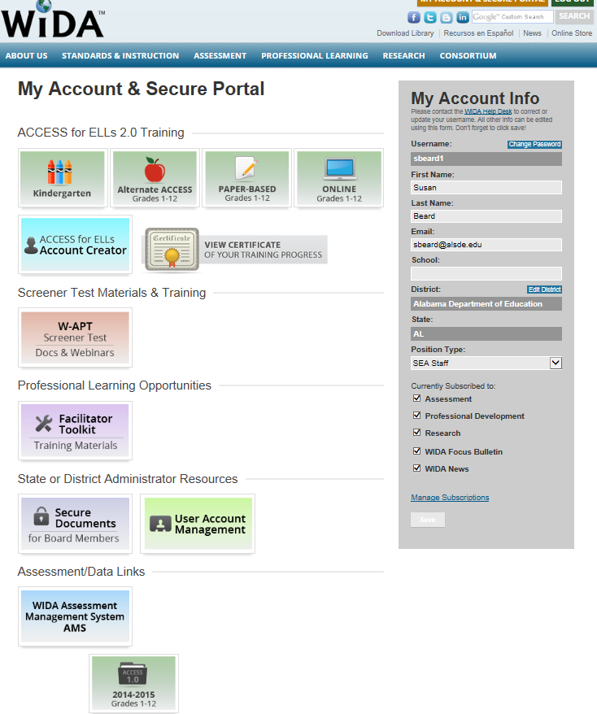
Online Training…
Notes:
Your screen may only show some of these tabs depending on how you were identified when you created your own log in credentials.
Click on Online Grades 1-12 and it takes you to the checklist.
Select Test Administrator only

Slide 15
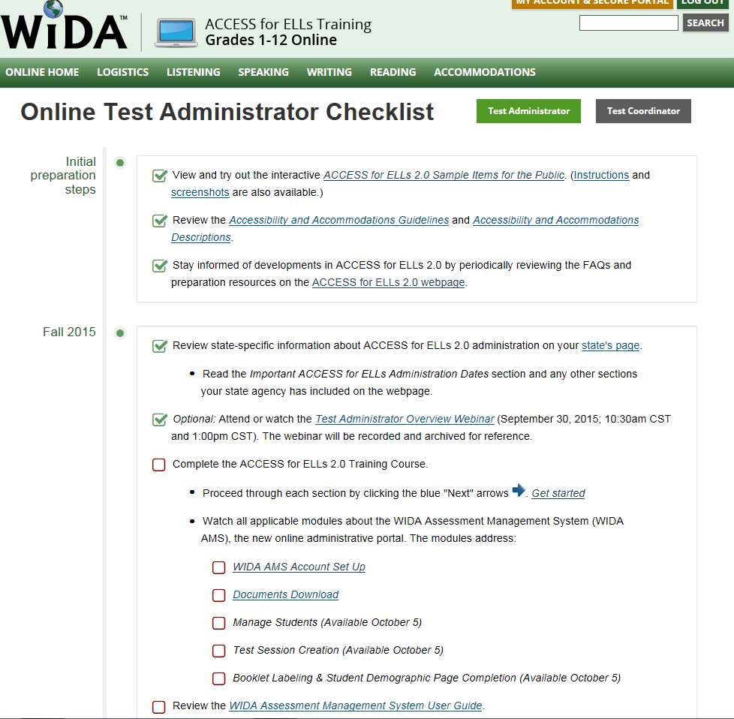
Online Training - Not So Quick!
Notes:
You are all ready to begin training and all you will see is basic highlights about each test and the words, Training Video Coming Soon!
You can watch the WIDA AMS video but you will not be able to access the actual portal until STCs have given you permission. Then you will receive an email from DRC with log in instructions.
As an EL Coordinator, you may be responsible for loading test administrators into the portal and assigning permissions. That will be a discussion you might want to begin with the STC.
Documents Download is a video on how to download documents. Pretty simple – all of the documents are in one place and you can download the ones you need.

Slide 16
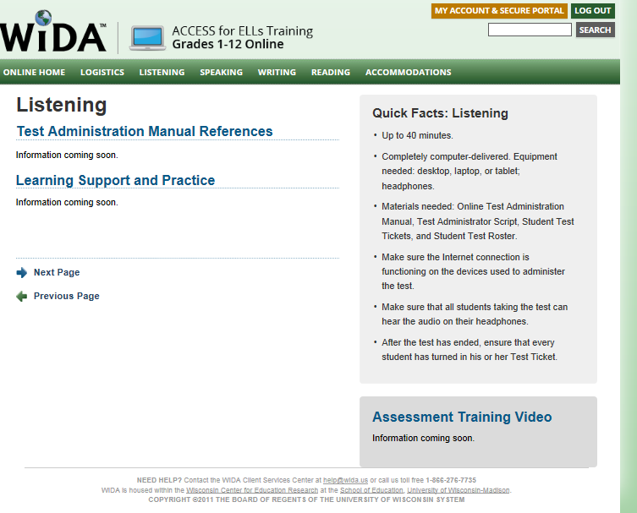
Online Training…
Notes:
Accommodations section is complete
October 5th is the magic date when most everything else will be released.

Slide 17
Additional Training Materials…
PowerPoints
Recorded Webinars
Test Administration Manuals
User Guides
Training Toolkit
Located in the Download Library on the WIDA website at www.wida.us

Slide 18
What Should I be Doing Now?
Make sure test administrators, as well as yourself, have created a Test Administrator account on the WIDA web site
using the following credentials: username: [alabama] password: [pinetree]
2. Use the Important Dates for ACCESS for ELLs 2.0 Training Opportunities and Materials document
as your training guide.
Follow the Checklists for Test Coordinators, Test Administrators, and Technology Coordinators to ensure that all
needed training is done.
Allow students to play around with the sample items and accessibility features!!
Notes:
Highlighter, Magnifier and line reader and color overlay. This is not meant to be a practice test but more of an opportunity to get a feel for the test.

Slide 19
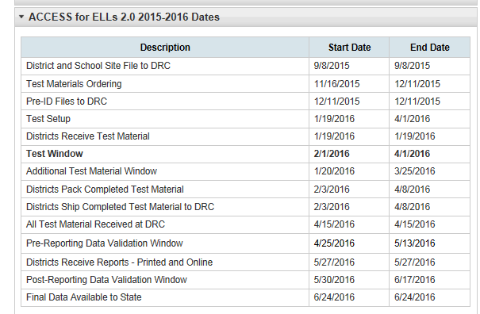
Testing Calendar

Slide 20
Need Help???
Susan Beard
sbeard@alsde.edu
334-242-8038
Data Recognition Corporation (DRC)
WIDA@datarecognitioncorporation.com
855-787-9615
WIDA
help@wida.us
866-276-7735

