Slide 1
Implementing the Uniform Guidance
Alabama Department of Education

Slide 2
Agenda
Goals of the Uniform Guidance and key takeaways
Guided tour of the Uniform Guidance and key changes to it
Resources
Timeline – when changes impact your grant

Slide 3
Goals of the Uniform Guidance and Key Takeaways
Supersede, Streamline and Consolidate eight existing OMB Circulars
Reduce administrative burden, increase flexibility, and improve outcomes (II. Major Policy Reform)
New “time and effort” flexibilities
Audit threshold changes
Effective dates for key changes

Slide 4
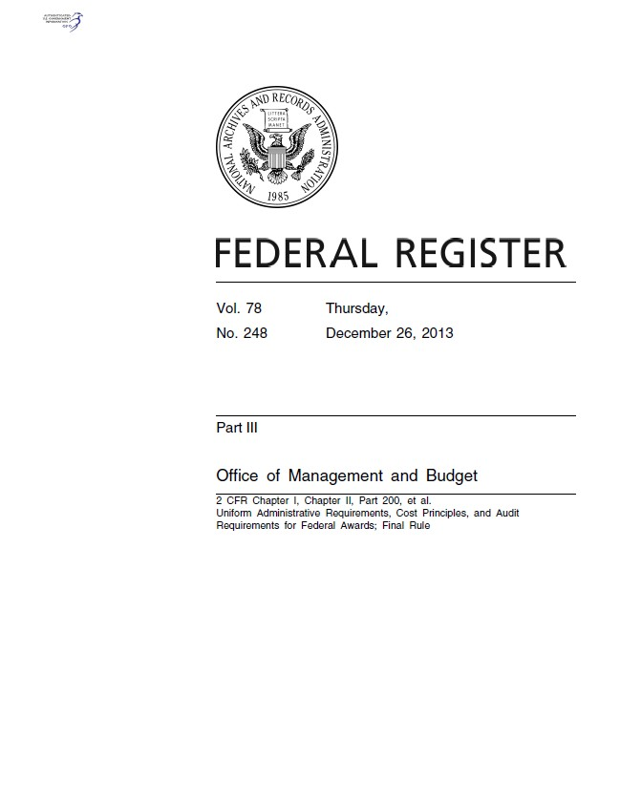
The Uniform Guidance follows the life-cycle of a a grant:
Subpart A – Acronyms and Definitions
Subpart B – General Provisions
Subpart C – Pre-Award Requirements
Subpart D – Post-Award Requirements
Subpart E – Cost Principles
Subpart F – Audit Requirements
Appendices III-V and VII – Indirect Cost and Cost Allocation Plans
Appendix XI – Compliance Supplement

Slide 5
Structure of the Federal Register (Dec. 2013)
Comments
Definitions
Regulations

Slide 6
Uniform Guidance Applies to ALL
The Uniform Guidance applies to both formula and discretionary grants in the same way that former EDGAR (34 CFR) Parts 74 and 80 did.
Regulations now found in one place.
If the type of award is not specified in a particular section, subpart or group of sections, then the requirement applies to all awards.
Formula Grant – noncompetitive awards based on a predetermined formula.
Discretionary Grant – awards funds on the basis of a competitive process
Q&A p. 1

Slide 7
From Circulars to the Uniform Guidance
Grants made prior to 12/26/2014 | Grants made on or after 12/26/2014
Circulars A-89, A-102, A-110 | Uniform Guidance Subparts B, C and D
Circulars A-21, A-87, A-122 | Uniform Guidance Subpart E
Circulars A-133, A-50 | Uniform Guidance Subpart F
EDGAR Parts 75 to 99 | EDGAR Parts 75-79 and 81-99
EDGAR Parts 74 and 80 | Become part of the Uniform Guidance

Slide 8
Timeline: Summary
Applies to all grants awarded on or after December 26, 2014
Audit and indirect cost changes take effect when your next fiscal year after December 26, 2014, starts
Grants awarded prior to December 26, 2014 and all supplements and admin actions to those grants are subject to former parts 74 or 80, as applicable
As of October 1, 2015 the majority of grant funds will be subject to the Uniform Guidance.

Slide 9
Subrecipient
Subrecipient means a non-Federal entity that receives a subaward from a pass-through entity to carry out part of a Federal program; but does not include an individual that is a beneficiary of such program. A subrecipient may also be a recipient of other Federal awards directly from a Federal awarding agency.
(Examples: LEAs and CBOs)

Slide 10
Key Changes
Post-Award

Slide 11
Key Changes in Post-Award Activities
Increased flexibilities and responsibilities sub-grantees:
Greater emphasis on internal controls to ensure compliance and ensure fiscal responsibility (§200.61 and §200.62)
Greater focus on performance expectations and results
Enhanced oversight requirements of subrecipients (LEAs) and contracts, which include risk assessment and use of monitoring tools

Slide 12
Outcomes and Performance
Will contracts using federal funding require greater emphasis on outcomes and performance than in the past?
The Uniform Guidance places increased emphasis on the substantive outcomes and performance of grants than has been the case in the past. See, for example,
2 CFR § 200.301 (Performance Measurement).
Sub-grantees, in obtaining services from vendors needed to implement their grant, will need to ensure that the timelines and quality of the work provided by their contractors will allow the sub-grantee to meet the performance standards that apply to its grant.
Contractors working with sub-grantees, therefore, may see greater emphasis on outcomes and performance than they have in the past.
Q & A p. 6

Slide 13
Key Changes to Procurement
Increased responsibilities for the Department and sub-recipients (LEAs):
New requirements for oversight of procurement dollars are found at
§200.317, §200.318, and §200.324 and include such changes as:
The entity must make available, upon request, technical specifications on proposed procurements to ensure the item or service is the one being proposed for acquisition.
The entity must make pre-procurement process documents available if certain conditions exist.

Slide 14
Supplies §200.94 and §200.453
Supplies means all tangible personal property other than those described in §200.33 Equipment. A computing device is a supply if the acquisition cost is less than the lesser of the capitalization level established by the non-Federal entity for financial statement purposes or $5,000, regardless of the length of its useful life. See also §§200.20 Computing devices and 200.33 Equipment.

Slide 15
Equipment §200.33 and §200.313(c)(1)
Equipment – items over $5,000.00
Use equipment for the program or project for which it was acquired as long as needed
Not encumber the property without prior approval of the Federal awarding agency
When no longer needed for original program the equipment may be used in other activities supported by the Federal awarding agency

Slide 16
Key Changes: Risk-Based Monitoring
Increased responsibilities for pass-through entities:
§200.331 (b) Pass-through entities must evaluate each subrecipient’s risk of noncompliance with federal laws, regulations, and grant terms and conditions, and determine appropriate monitoring actions.
Considerations:
Prior experience with the same or similar sub-award
History of audits
New personnel or new systems
Relevant state monitoring (repeated citations, large percent of citations)

Slide 17
Key Changes: Risk-Based Monitoring(cont.)
Increased responsibilities for Pass-through entities:
Under §200.330 and §200.331 (d) SEA monitoring of LEAs must include:
Review of financial and performance reports
Issue management decisions for audit findings on subrecipients
Ensure that the subrecipients take timely, appropriate action to cure deficiencies by implementing Corrective Action Plan (CAP)

Slide 18
Current Monitoring Practices (§200.331)
Self-assessment
Desk Audit
Onsite Monitoring
Risk-based Monitoring (more frequent onsite visits)

Slide 19
Key Changes
Cost-Principles

Slide 20
Cost Principles: Notable Changes
§200.407 lists 22 prior approval requirements. However, some pre-approvals were missed, so check specific cost principles before assuming that they don’t require prior approval (Prior approval in the eGAP application process)
New Requirements:
Certifications are required for fiscal reports, payment vouchers, and indirect cost proposals
Limited dependent care costs related to conferences
Does not override the Department guidance regarding conferences
Direct charging of materials and supplies
Computer equipment <$5,000 specifically treated as supply

Slide 21
Dependent Care Cost
What does the Uniform Guidance say about dependent care at conferences?
A grantee that hosts a conference can charge the grant the costs incurred in researching dependent care, if that care is required for a conference participant. The actual dependent care cannot be charged to the conference by the host. However, if a grantee sends a person to attend a conference and that attendant’s dependent care costs increase as a result of that attendance, then the costs that exceed the attendant’s normal dependent care costs can be charged to the grant of the grantee that sends the attendant. (Example: MEGA)(§200.456)
Q & A p. 12

Slide 22
SDE and LEA: Reminder
Basic standards for allowability remain the same:
Necessary – must be necessary for the performance or administration of grant
Reasonable – must follow sound business practices; fair market price
Allocable – process of assigning a cost, or a group of costs, to one or more cost objective(s), in reasonable proportion to the benefit provided or other equitable relationship
Documented – “paper trail” of how funds are used

Slide 23
Be Practical
Practical aspects of “reasonable”
Is the expense targeted to valid programmatic/administrative considerations?
Do I have the capacity to use what I am purchasing?
Did I pay a fair rate? Can I prove it?
If I were asked to defend this purchase, would I be comfortable?
Practical aspects of “necessary”
Do we really need this?
Is this the minimum amount I need to spend to meet the need?

Slide 24
Be Practical
Practical aspects of “allocable”
Can I prove the program benefited?
Time and effort records
Can I prove other programs are not benefiting?
Ensuring only authorized use
Practical aspects of “adequate documentation”
Award amount
Details of how funds are used
Total cost of project
Records showing compliance with rules and regulations
Records showing performance

Slide 25
Conferences: §200.432
A conference is defined as a meeting, retreat, seminar, symposium, workshop or event whose primary purpose is the dissemination of technical information beyond the non-Federal entity and is necessary and reasonable for successful performance under the Federal award.
Allowable conference costs paid by the non-Federal entity as a sponsor or host of the conference may include:
Rental of facilities,
Speakers’ fees,
Local transportation,
Other items incidental to such conferences unless further restricted by the terms and conditions of the Federal award.

Slide 26
Conferences cont’d: §200.432
Conference hosts/sponsors must exercise discretion and judgment in ensuring that conference costs are appropriate, necessary and managed in a manner that minimizes costs to the Federal award.

Slide 27
Cost Principles
What is meant by the term blended? Is that the same as comingling of funds?
Comingled funds: A grantee (or subgrantee) comingles funds when Federal funds received from a particular grant are deposited to an account that also contains other Federal or non-Federal funds and fails to maintain the internal controls needed to separately track the funds for that grant. Because grant funds cannot be traced to determine how they are expended, there is no way to determine if the comingled grant funds were expended on allowable costs.
Q & A p. 9

Slide 28
Cost Principles Cont’d.
“Blended” Funds: When a grantee (or subgrantee) gets funds from more than one program or agency to conduct the same or closely related activities under a single grant or multiple grants, §200.430 authorizes the grantee to account for the combined use of the Federal funds if certain conditions are met. The Uniform Guidance calls this “blended” funding and a grantee would establish a single cost accounting code to account for any blended funds.
Q & A p.9

Slide 29
Implications: Time and Certification Reporting
New flexibility: “system of internal controls” for documenting personnel compensation
Requirements for personnel compensation are found at
§200.430-431.
Historically time and certification reporting has been a key area of audit findings.

Slide 30
Personnel Expenses: §200.430(1)(B)
Charges to Federal awards for salaries and wages must be based on records that accurately reflect the work performed. These records must:
Be supported by a system of internal control
Be incorporated into the official records of the non-Federal entity
Reasonably reflect the total activity for which the employee is compensated by the non-Federal entity
Encompass both federally assisted and all other activities compensated by the non-Federal entity on an integrated basis

Slide 31
Personnel Expenses cont’d: §200.430(1)(B)
Comply with the established accounting policies and practices of the non-Federal entity
Support the distribution of the employee’s salary or wages among specific activities or cost objectives if the employee works on more than one Federal award
Budget estimates (i.e., estimates determined before the services are performed) alone do not qualify as support for charges to Federal awards, but may be used for interim accounting purposes
DRAFT

Slide 32
Personnel Expenses cont’d: §200.430(1)(B)
Significant changes in the corresponding work activity (as defined by the non-Federal entity’s written policies) are identified and entered into the records in a timely manner.
Short term (such as 1 or 2 months) fluctuation between workload categories need not be considered as long as the distribution of salaries and wages is reasonable over the longer term

Slide 33
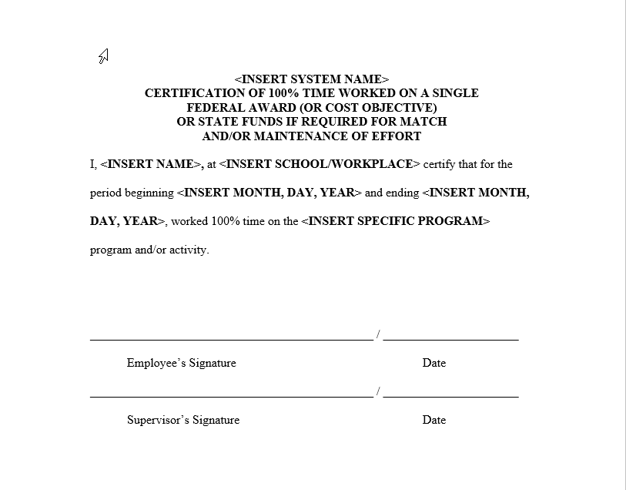

Slide 34
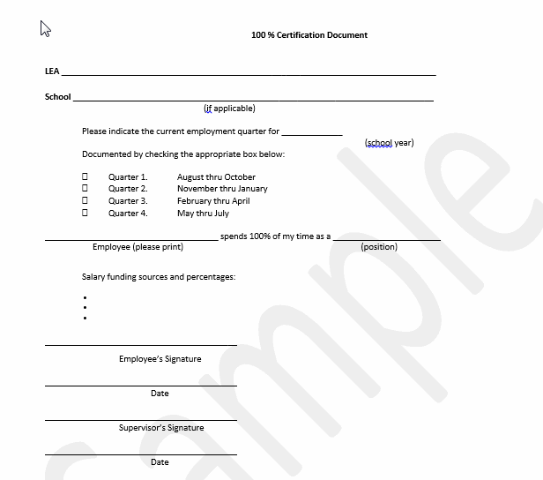

Slide 35
Key Changes
Indirect Costs

Slide 36
Key Changes in Indirect Costs
Flexibility for new Grantees: de minimis rate of 10% MTDC
Under §§75.561 & 76.561 procedures, States and LEAs not eligible
De minimus rate not to be confused with Department’s temporary rate of 10% direct salaries and wages
New grantees that have never had rate have option to negotiate ICR and use temporary rate OR to just use de minimis rate BUT
Grants subject to “supplement not supplant” must use restricted rate
Training grants must use 8% MTDC rate under §75.562

Slide 37
Key Changes in Indirect Costs (cont’d)
New flexibility: Grantees with a negotiated rate may apply for an extension of up to 4 years.
Reduces the requirement to renegotiate annually
Requests for extensions must be submitted 4 months after the end of the grantee’s fiscal year (60 days earlier than due date for indirect cost proposals)

Slide 38
Direct v. Indirect Costs 200.413
NEW: Salaries of administrative and clerical staff should be treated as “indirect” unless all of following are met:
Such services are integral to the activity
Individuals can be specifically identified with the activity
Such costs are explicitly included in the budget
Costs not also recovered as indirect

Slide 39
When Does This Start?

Slide 40
Reminder of Timeline: Summary
Applies to all grants awarded on or after December 26, 2014
Audit and indirect cost changes take effect when your next fiscal year after December 26, 2014, starts
Grants awarded prior to December 26, 2014 and all supplements and admin actions to those grants are subject to former parts 74 or 80, as applicable
As of October 1, 2015 the majority of grant funds will be subject to the Uniform Guidance.

Slide 41
Timeline: Grants Admin/Cost Principles
Prior Circulars and regulations apply to all awards issued prior to December 26, 2014:
New Award
Continuation Award
Administrative Actions and Supplements to these awards up to September 30, 2015
Uniform Guidance (2 CFR 200) applies to:
New and Continuation grants awarded on or after December 26, 2014

Slide 42
Timeline: Grants Admin/Cost Principles
Carryover funds for state-administered programs:
Uniform Guidance applies to funds carried over at the end of FY 2015 to FY 2016 (on October 1, 2015) (Title I Uniform Guidance p.42, D. Carryover)
Example: A Title I grant awarded on July 1, 2014 has existing terms/conditions (based on former Part 80). If any of those funds are unobligated and carried over to FY 2016 (10/1/15), they will have to be used and accounted for consistent with the new Uniform Guidance.

Slide 43
Timeline: Audits
Audit requirements apply to the first fiscal year beginning after December 26, 2014
  Work with your auditor to ensure that he or she is prepared to address and report on the new requirements.
Example: A state’s fiscal year begins Oct. 1, 2015. The state’s fiscal year ends on Sept. 30, 2016. You must submit your audit within 9 months, by May 31, 2017 in this example.

Slide 44
Timeline: Indirect Cost
Indirect Cost requirements apply to the first fiscal year beginning after December 26, 2014.
  Work with your cognizant agency to ensure your indirect cost rate proposal reflects decisions appropriate for your program
Example: The grantee fiscal year ends June 30, 2015. Your rate proposal is 6 months after the end of the current fiscal year, due December 31, 2015. Requests for extensions must be submitted 60 days prior to the due date of proposal submission, or October 31, 2015 in this example.

Slide 45
Resources:
Please visit ED’s one-stop shop for information
Email questions to uniformgrantguidanceimplementati on@ed.gov
Contact your Department program liaison

