Slide 1
E-gap and lea accounting
Leah Johnston
September 5, 2019

Slide 2
School reconfigurations for e-gap
Before numbers come from the Fall 20th day after Labor Day Report
(Previous school year)
After numbers should be loaded into e-Gap once grade spans have been adjusted

Slide 3
Reconfigurations cont.
It is VERY important for you to verify your Enrollment and Free/Reduced Numbers that were uploaded on the 20th day after Labor Day because those numbers are where the numbers on the Title I Building Eligibility Page for rank order come from.
If a discrepancy is detected please contact the SDE that day. Don’t wait until the following summer when the numbers are loaded into e-Gap.
You should be able to pull the enrollment reports from our website.
The Following reports are used when moving students from 1 school to another:
Enrollment By System, School, Sex and Race Report because it lists enrollment numbers by grade.
Free and Reduced By Grade which breaks down the number of students per grade receiving a free or reduced lunch.

Slide 4
Browsers for eGAP

Slide 5
Administrative Costs Reminder:
Title I Cap of 15%
(Admin plus Indirect Costs)
Title II Cap of 5%
Title III Cap of 2%
Title V Cap of 5%

Slide 6
Capitalized equipment purchases should meet the following criteria:
Retains its original shape and appearance with use.
Under normal conditions is expected to serve its intended purpose for longer than one year.
Is non-expendable; that is, if the item is damaged or some of its parts are worn, it is feasible to repair
the item than replace it.
Has a unit cost of $5,000.00 or more.

Slide 7
Title I set asides
Function Code 6XXX
Function Code 6910; Object code 910
Function code 2215
Program code 1850
Program code 1890
Program code 1851
90% coded to local school cost center
10% coded to pooled cost center
Function Code 2190
Current year allocation
Coded to pooled cost center (except parent and family engagement coded to local schools)
Coding for set asides reviewed by LEA Accounting is listed in the 2018 Budget Desk review located on the states website. (www.alsde.edu>Sections>LEA Accounting>Budget Submission)
Transportation for public school choice and foster care should use transportation function/program code
Program code 1852
Program code 1750
Program code 1815
Use transportation function and program codes
This amount should tie back to the PPA Page Column G

Slide 8
Parent and Family Engagement Validations in egap
Four validations that are set up for Title I-A regarding the Parent and Family Engagement set aside:
Set Asides
If the district receives at least $500,000 in allocation, the Parent and Family Engagement set aside amount can’t be less than 1% of the Title I-A allocation.
The Parent and Family Engagement set aside amount needs to be equal to the total amount budgeted towards in the 90% portion (on the School Allocation PPA List page) + the total amount budgeted towards District Parent and Family Engagement Activities (on the Schoolwide and Targeted Assistance Budget Details pages).
School Allocation PPA List
If the district receives at least $500,000 in allocation, the total amount budgeted towards the 90% portion can’t be less than 90% of 1% of the allocation.
Schoolwide/Targeted Assistance Budget Details
If the district receives at least $500,000 in allocation, the total amount budgeted towards District Parent and Family Engagement Activities can’t be less than 10% of 1% of the allocation.

Slide 9
eGap

Slide 10
Parent & Family Engagement 1%

Slide 11
PPA PAGE
90%

Slide 12
eGap
Title I – Budget Details Page
10%
Total Cost should be: $1,118.28

Slide 13
eGAP Reminder:
On the Parent and Family Engagement Worksheet, Use the Public Low-Income students on the Building Eligibility Page in eGAP.

Slide 14
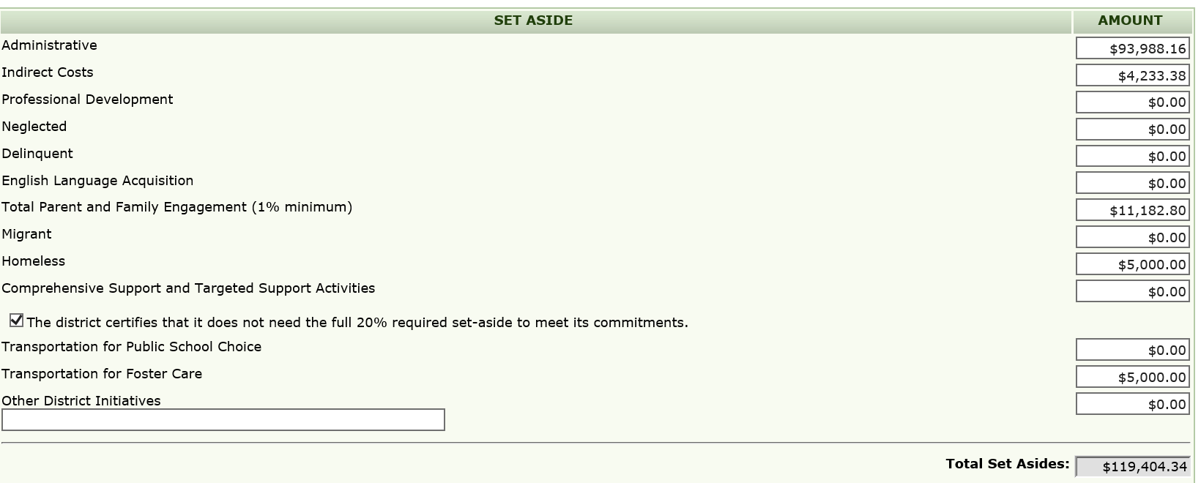
Does the ESEA require an LEA to reserve Title I funds under section 1113(c)(3) if all schools in the LEA are Title I schools? Homeless set asides
Yes, ALL LEAS that receive Title I funds must set aside funds. ESEA required that an LEA reserve funds necessary “to provide services comparable to those provided to children in [Title I schools] to serve homeless children and youths who do not attend [Title I] schools, including providing educationally related support services to children in shelters and other locations where children may live.

Slide 15
Allocation and carryover
Carryover does not go in the set aside area
Carryover is added to the allocation calculation at the top of the set asides page
Amount entered is carryover amount MINUS any district initiatives. Only the amount going to the schools is entered
Carryover amount going to local schools

Slide 16
Carryover Notes
Schools do not “earn” carryover.
Private Schools do not receive carryover.
Three options for the use of Title I carryover:
Disburse carryover funds to schools; use a set formula to allocate funds to schools with the highest concentration of poverty, thus providing a higher per-pupil amount to those schools, OR…
Provide additional funds to any of the activities supported by the reservations for district-wide initiatives
BOTH!

Slide 17
Set-Asides
Carryover money is NOT added at the bottom
of the set-asides page.
If carryover is added to a district initiative,
put a comment in the comment log,
put in an action step, and
budget carryover money on the budget page.
Current Year Money Only

Slide 18
Ppa page
Column G should tie back to set aside page
Remaining amount should be as close to $0 as possible and cannot be negative (Parentheses around number means negative)
If sending carryover to schools the PPA page has to be updated to include the additional funding
FY 2018 - NO LONGER SHOWS ALLOCATIONS FOR PRIVATE SCHOOLS
($0.38)
Negative Number

Slide 19
Private school allocations
Allocation begins on Building Eligibility Page
Enter number of students participating by local school zone
Total number participating carries over to set aside page

Slide 20
Private school cont.
Amount for private schools should be coded to Function Code 9200, Cost Center 9400 range and Program Code 4900

Slide 21
FTE’s (Full Time Equivalent)
Personnel – Total bodies filling the positions
FTE’s – percent of time that 1 person is working. **A person working 3 months of the 12 month year would be 0.25 FTE’s.
All federal FTE’s must be programmatically approved. At year end if you have salaries paid from federal funds that are not in e-Gap you must revise e-Gap to get them approved.
FTE’s can exceed insurance in file with explanation of Retired/PT staff not receiving benefits.
Insurance FTE’s should never exceed FTE’s listed in e-Gap

Slide 22
Migrant – 4115
Verify FTE’s and allowable activities to the right are coded correctly.

Slide 23
N&D - 4116
Verify FTE’s and coding of activities described below. All Expenditures must use program code 1810 and there can be 0% administrative expenditures.

Slide 24
Title I – School Improvement - 4120
Verify FTE’s and allowable activities to the right are coded correctly.

Slide 25
Title II - 4130
Verify FTE’s and coding of activities described below to include any private school activities.

Slide 26
Title III - 4150
Verify FTE’s and coding of activities described below to include any private school activities. Administrative limitation is 2%. If required to use portion on Immigrant students, identify expenditures with special use 0073.

Slide 27
Title V-B - 4180
Verify FTE’s and coding of estimated costs of Rural Funds listed to the right.

Slide 28
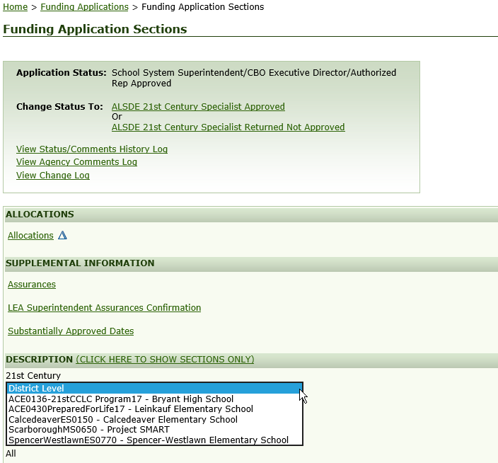
Title IV 21st Century - 4161

Slide 29
4161 Continued
Function code 9130 because non-regular day. If teacher hired just for program use object code 134. If current contract teacher with additional duties use object code 199. Professional Development limited to 5% of CURRENT allocation and uses function code 2215. Transportation limited to 25% of current allocation and uses transportation function/program codes. Administrative expenditures limited to 20% of current allocation and uses a 6000 range function code.

Slide 30
Homeless - 4195
Verify FTE’s and coding for estimated costs below.

Slide 31
ACCOUNTING REPORTS IN AIM
Accounting file E-Gap Budget Grid – Mirrors Budget Grid in e-Gap application for all fund sources
Fund Source Financial – shows Budget vs. Actual expenditures to determine when amendments are necessary
Indirect Cost Earned vs. Budgeted
Indirect Cost Earned vs. Collected
Indirect Cost Rates

Slide 32
E-Gap Grids
These are verified for every federal fund source in e-Gap.
E-Gap Grid from Application
E-Gap Grid from accounting upload

Slide 33
Fund Source Financial

Slide 34
Indirect Cost Earned vs. Budgeted

Slide 35
ALLOCATION PROCESS
ORIGINAL ALLOCATIONS
ORIGINAL ALLOCATIONS FOR COMPETITIVE FUNDS
FEDERAL ALLOCATIONS ARE LOADED INTO E-GAP ONCE THEY ARE EMAILED TO LEA’S
E-GAP APPLICATION MUST BE FINAL APPROVED BY FEDERAL PROGRAMS
APPROVAL OF APPLICATION LOADS ALLOCATION INTO ES-2 SO FUNDS MAY BE REQUESTED
EXCEPTION IS COMPETITIVE FUNDS
LEA APPLIES FOR FUNDS
FEDERAL PROGRAM APPROVES FUNDS AND DETERMINES ALLOCATION
E-GAP RETURNED TO LEA TO BUDGET THE AMOUNT ALLOCATED
APPLICATION GETS SPECIALIST APPROVED BY FEDERAL PROGRAMS
FEDERAL PROGRAMS SUBMITS SCORING FILE TO LEA ACCOUNTING TO LOAD
ONCE SCORING FILE IS LOADED APPLICATION MUST MOVE TO REVIEWED STATUS TO LOAD INTO ES-2

Slide 36
CARRYOVER ALLOCATIONS
FINANCIAL STATEMENT APPROVAL
FINAL EXPENDITURE REPORT APPROVAL IN E-GAP LOADS CARRYOVER TO APPLICATION
APPLICATION APPROVED WITH CARRYOVER FUNDS MOVES FUNDS TO ES-2
SYSTEMWIDE BUDGET AMENDMENT MUST BE APPROVED FOR YOU TO RECEIVE CARRYOVER FUNDS

Slide 37
E-GAP – NEW USER SET UP
NEW SUPERINTENDENT IS SET UP BY SDE
SUPERINTENDENT OR HIS/HER DESIGNEE SETS UP EVERYONE ELSE
SDE CAN SET UP ANYONE IF EMAILED BY SUPERINTENDENT
SDE NEEDS EMAIL ADDRESS, PHONE NUMBER, ROLES REQUIRED TO SET A USER UP
NOTE: IF USER HAS USERNAME, ONLY CHANGE PERSONAL INFORMATION AND ROLES – DO NOT CREATE NEW USER

Slide 38
334-694-4628
ljohnston@alsde.edu

