Slide 1
21st Century eGAP Application Training FY 2017 Due May 13, 2016

Slide 2
Getting EGAP Access
Current LEA Grantees-Can use your same login information. If there are changes to any of the three persons in the approval chain, your CSFO or superintendent can enroll new users and delete persons who will no longer be users.
New LEA Grantees-Your LEA’s CSFO or Superintendent can give you access to the eGAP system.
Current CBO Grantees-Can use your same login information. If there are changes to any of the three persons in the approval chain, your CBO eGAP manager can enroll new users and delete persons who will no longer be users.
New CBOs-From your Letters of Intent, Joslyn Reddick has placed your parent organization into the system and issued them a Parent Organization Code. An email with the information will be sent to the person on the Letter of Intent with the organization’s code. After your Approval Chain form is received, persons whose names are contained in the approval chain will receive an email from eGAP@alsde.edu with a link to create a username and password. You can then access the system to begin your grant application.

Slide 3
Hardware/Internet Specifications
Up-to-date computer hardware
Internet Explorer, Firefox, or Google Chrome

Slide 4
Logging into eGAP

Slide 5
Session Timeout
If the system is inactive after 60 minutes, it will time out.

Slide 6
Funding Applications Page
The application year is defaulted to the current fiscal year which is 2016. Click on the dropdown list and change the year to 2017.

Slide 7
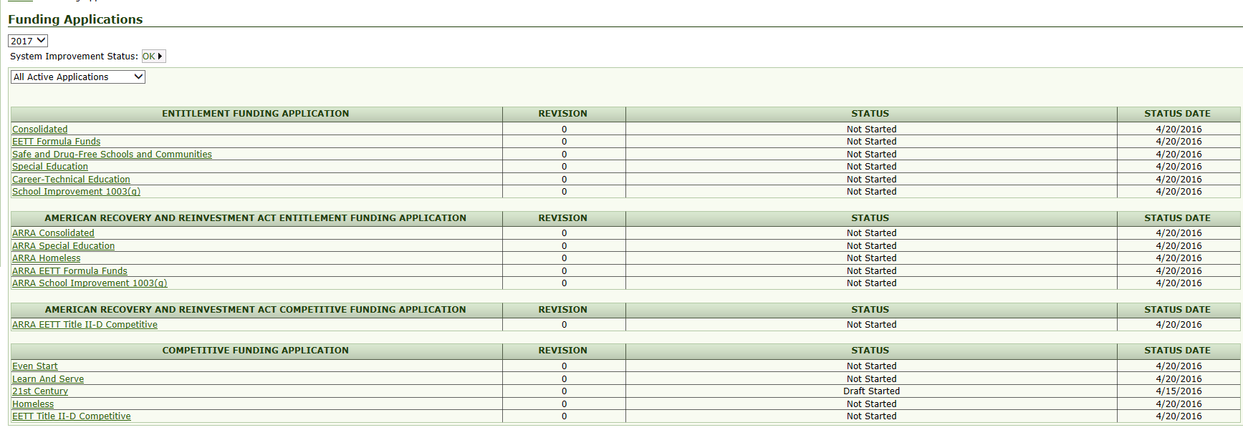
Click on 21st Century Application Link

Slide 8
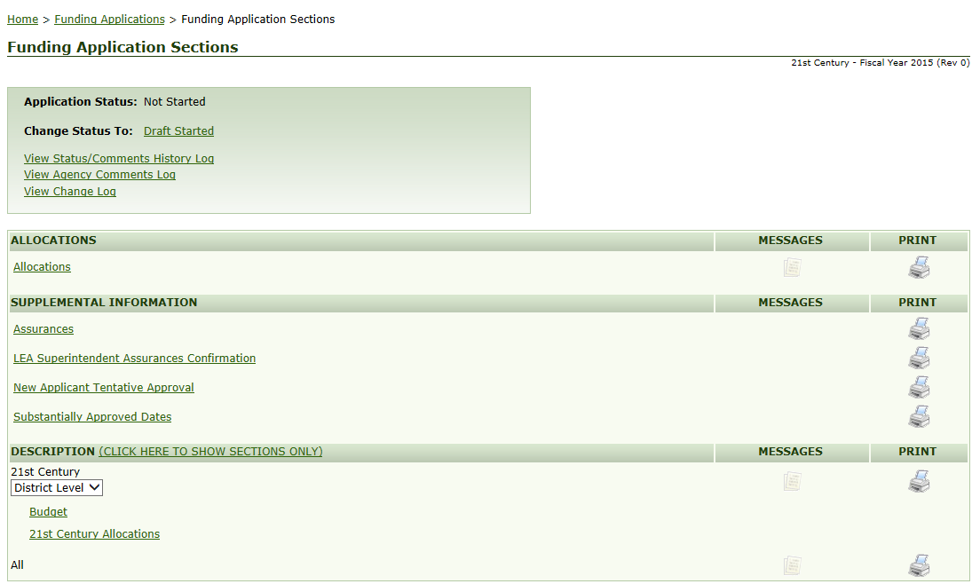
Draft Started

Slide 9
Draft Started Confirmation

Slide 10
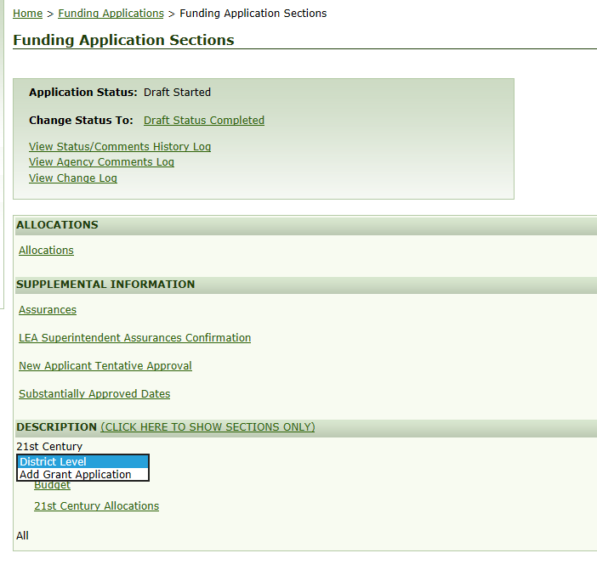
Add Grant Application
If you are applying for multiple sites, you cannot add additional sites until you have completed the application for your first site. You will return to this page (Add Grant Application) in eGAP after you have completed the Related Documents Page. Then you can add the next site.

Slide 11
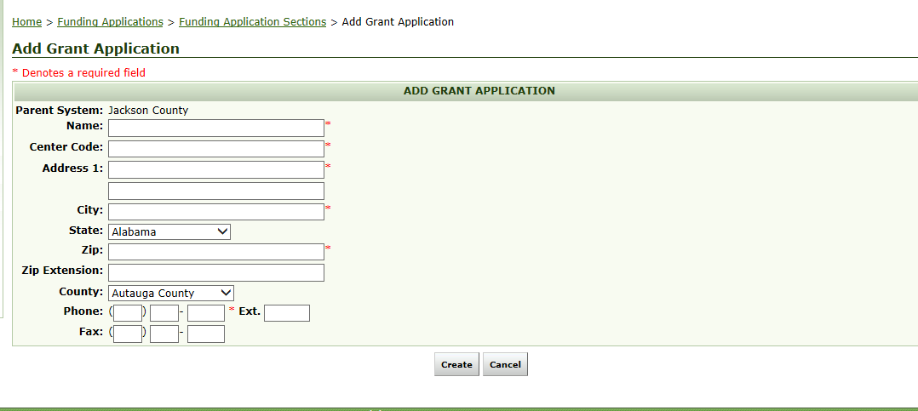
Add Grant Application

Slide 12
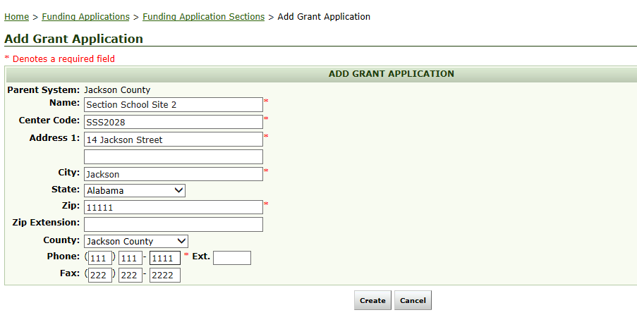
Add Grant Application Site Name
Name of the LEA or CBO. Generated in eGAP.
This is not a person’s name nor the LEAs name. This is the name of the 21st Century site.
Note: If you are a former grantee and are applying for a new grant, you cannot use the former site name.
You must create a new and unique site name.

Slide 13
Creating Center Codes
LEAs
Must be short and simple
No Special characters or spaces
Cannot use the Parent Organization Code i.e. your LEAs cost center code as part of your center code
You can use your school’s cost center code as part of your center code
If you were a previous grantee who rolled off of the grant cycle, you cannot use the old center code. You must create a new and unique code.
CBOs
Must be short and simple
No Special characters or spaces
Cannot use the Parent Organization Code i.e. the code issued to your CBO by Joslyn Reddick. You will need to identify a number if you choose to use it in your code.
If you were a previous grantee who rolled off of the grant cycle, you cannot use the old center code. You must create a new and unique code.

Slide 14
Examples of Appropriate Center Codes
ALSDE Afterschool STEM Center
Site name + Cost Center Code
ALSDEAfterschool114
Site name initials + Cost Center code
AASC114
Site Name + year
ALSDEAfterschool2017
Site initials + Year
AASC114
If applying for multiple sites
ALSDE Afterschool STEM Center
AASCsite1 AASC01
AASCsite2 AASC02

Slide 15
Inappropriate site codes
Name + Cost CenterCode
ALSDE Afterschool STEM Center 0114
Too long
Contains spaces
Initial + Cost Center Code + grant +school name
ALSDE049-21cc-ALSDE STEM Center
Too long
Special characters
Spaces

Slide 16
Creating Center Code

Slide 17
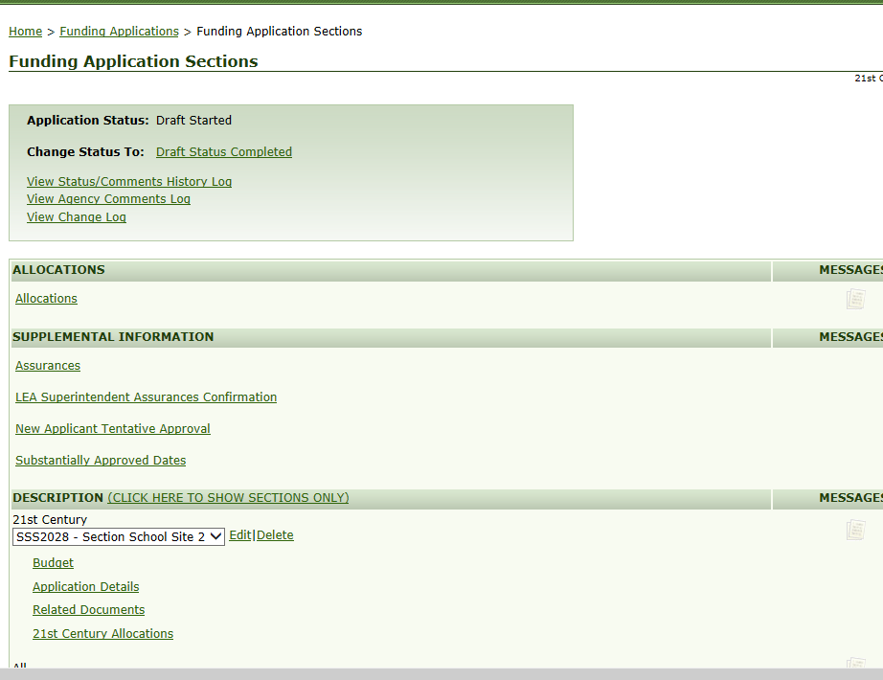
Edit and Delete Site
If you click delete, it will delete everything! Only use
this function if it is absolutely necessary.

Slide 18
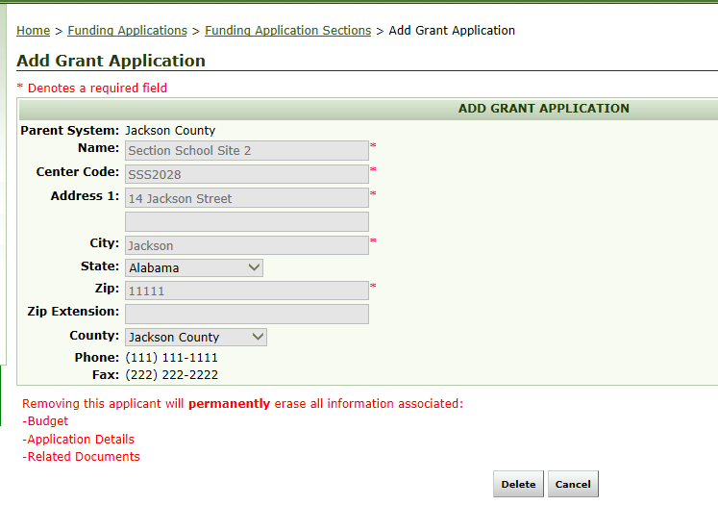
Delete

Slide 19
Save and Go/Cookie Trail

Slide 20
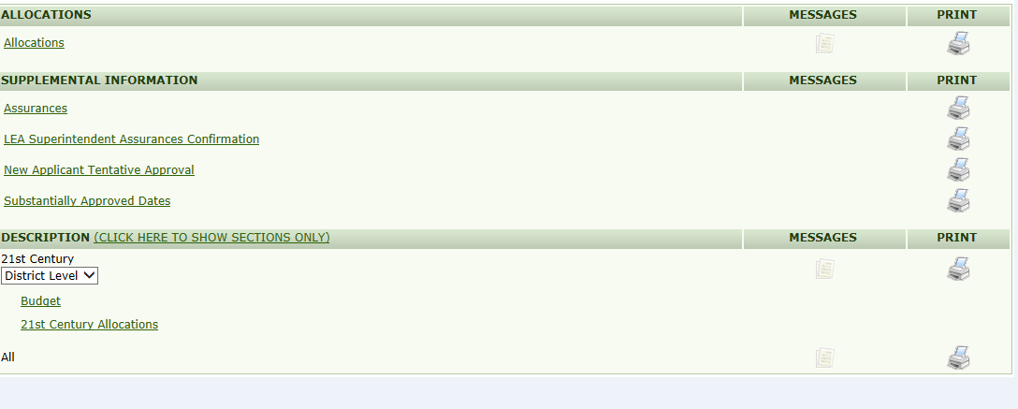
Budget

Slide 21
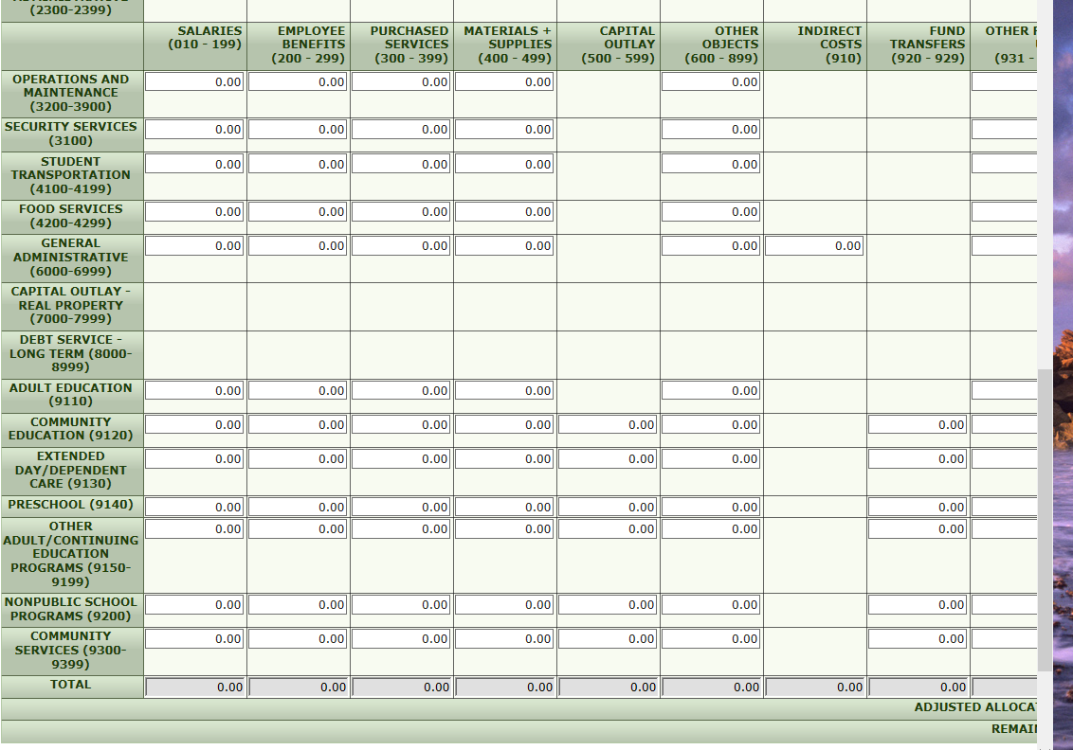
Budget

Slide 22
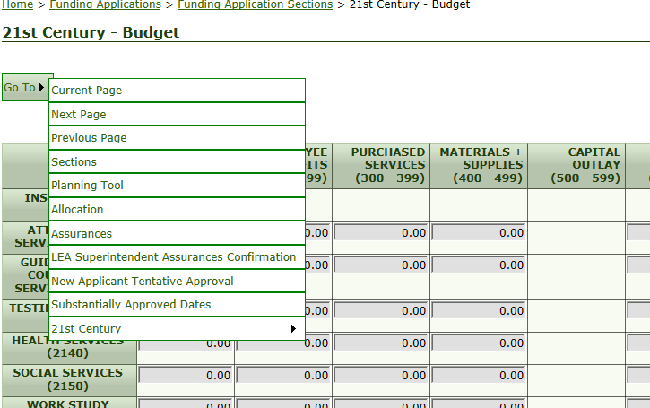
Budget Save and Go

Slide 23
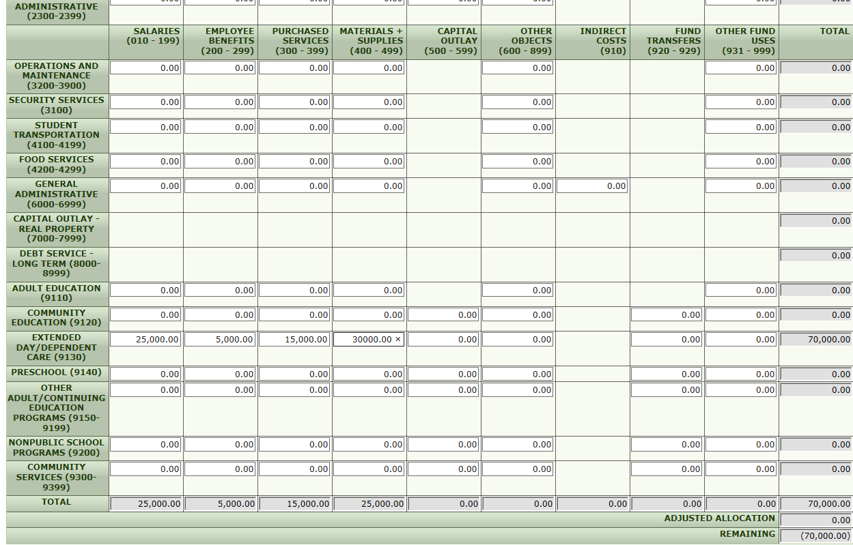
Input Budget
To add figures to your budget, click on the space under the appropriate function and object. Delete the 0.00 by
clicking on the x beside it. Put in the amount you want budgeted for that function and object.
When you put in the budget for the site(s), it will automatically roll up top the district’s/parent organization’s budget.

Slide 24
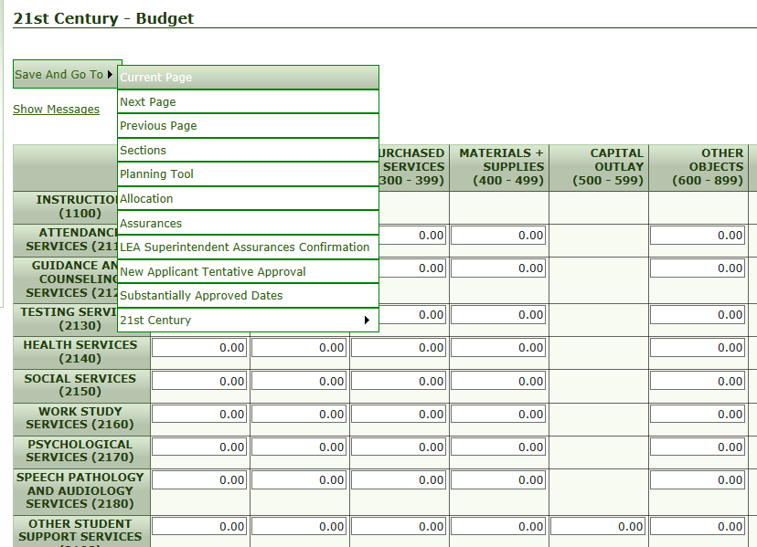
Save and Go

Slide 25
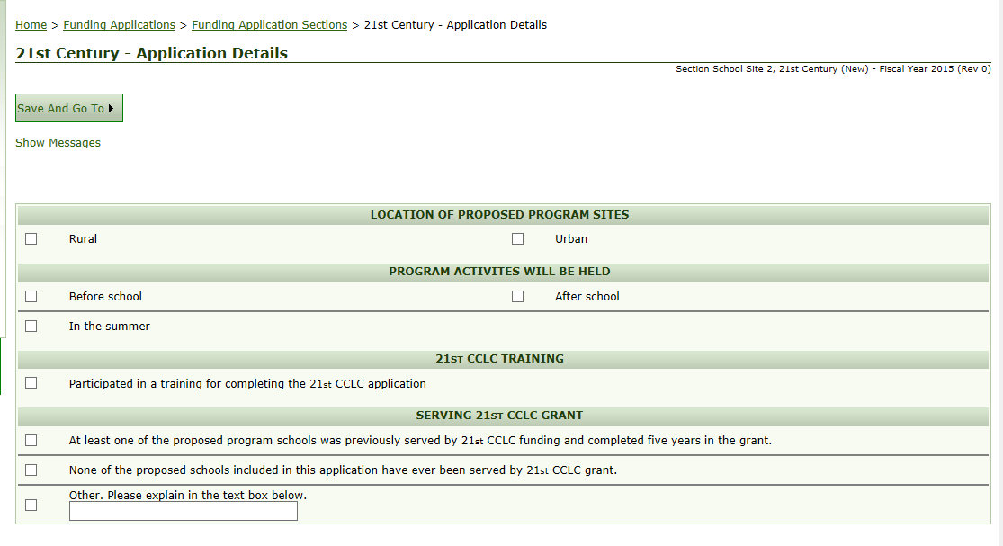
Application Details

Slide 26
Needs Assessment

Slide 27
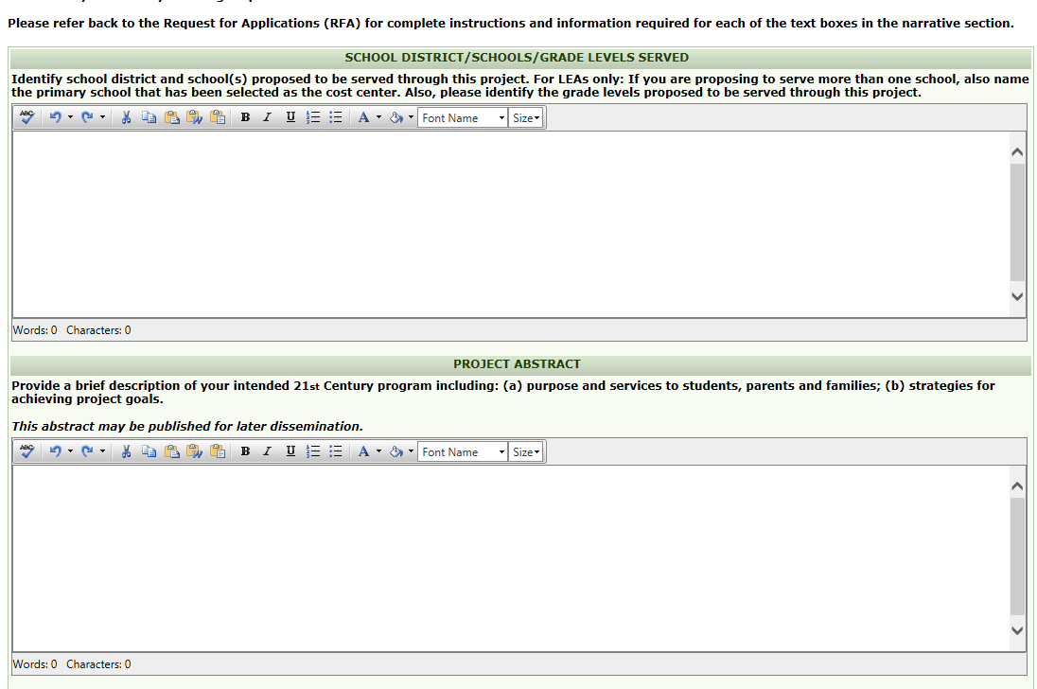
Application Details Continued

Slide 28
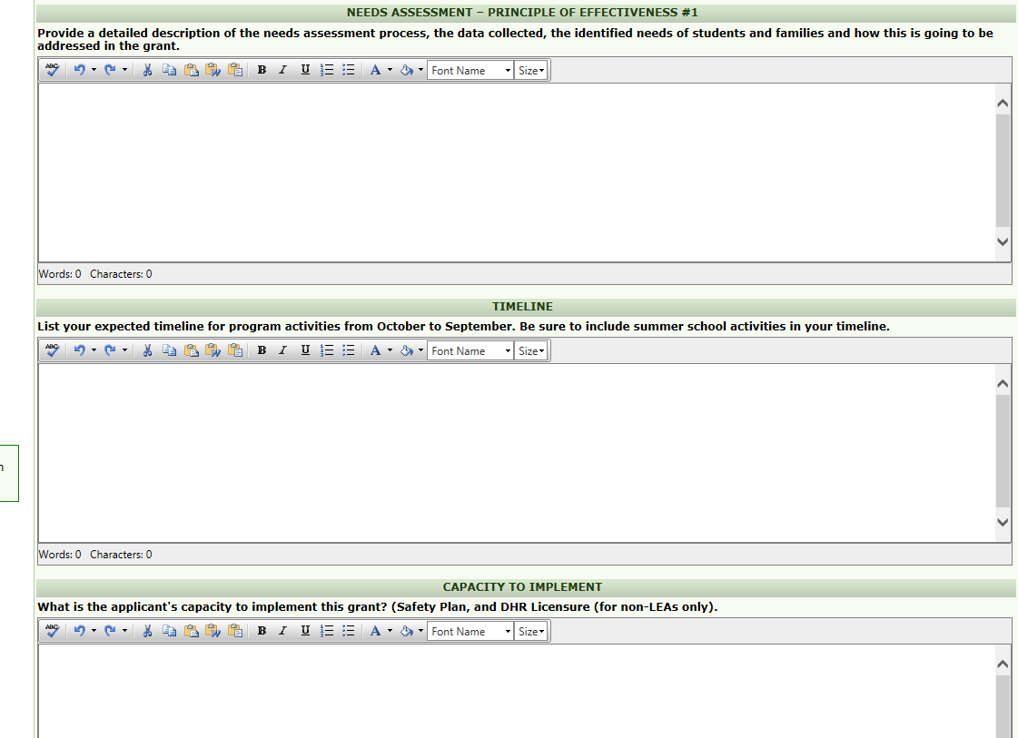
Application Details Continued

Slide 29
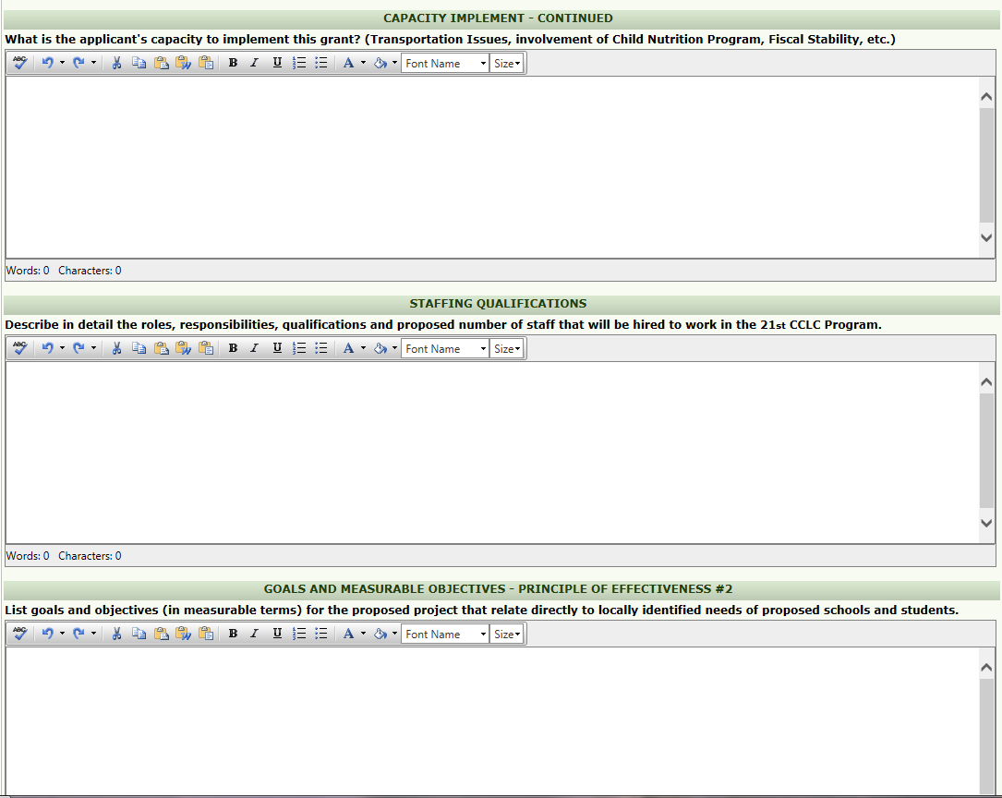
Application Details Continued

Slide 30
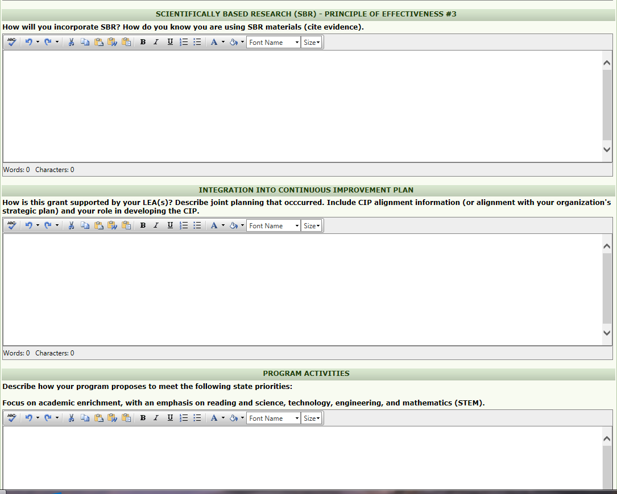
Application Details Continued

Slide 31
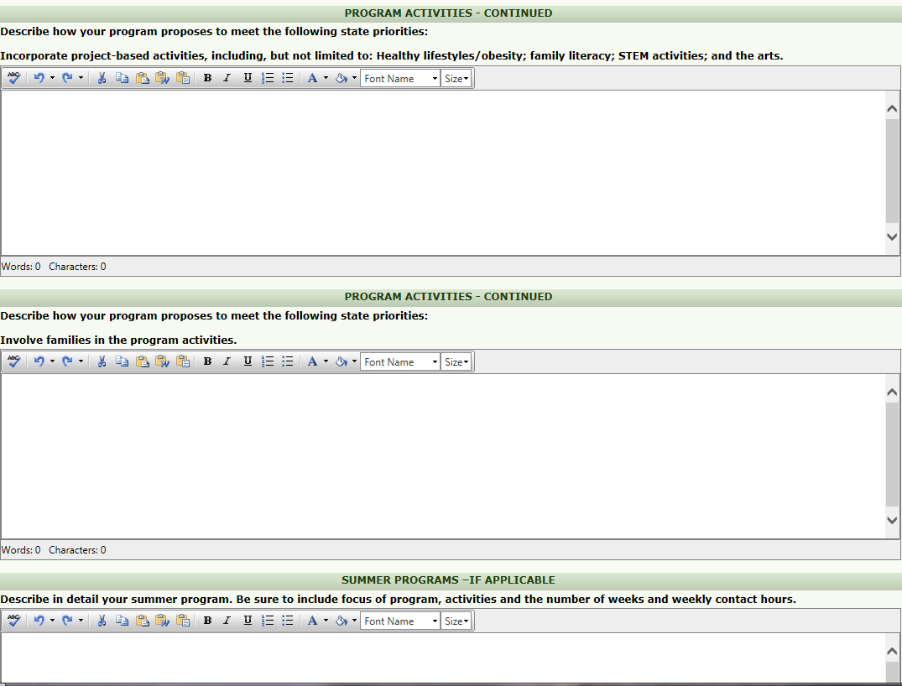
Application Details Continued

Slide 32
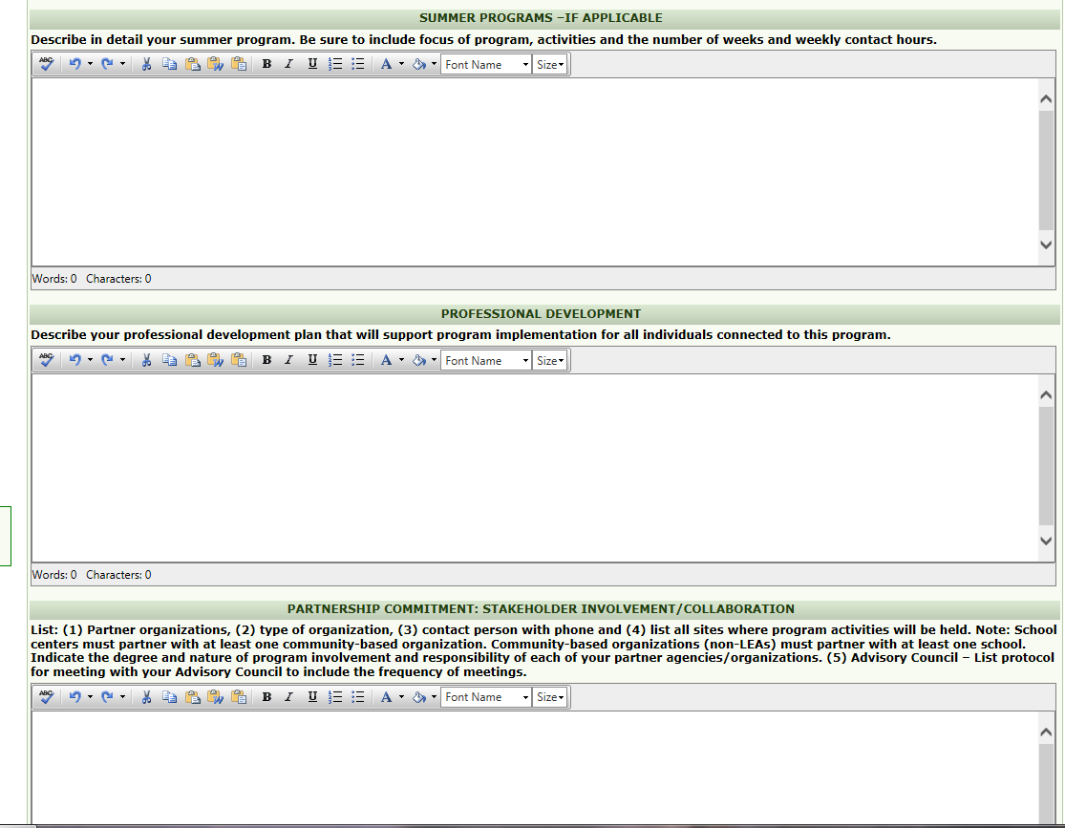
Application Details Continued

Slide 33
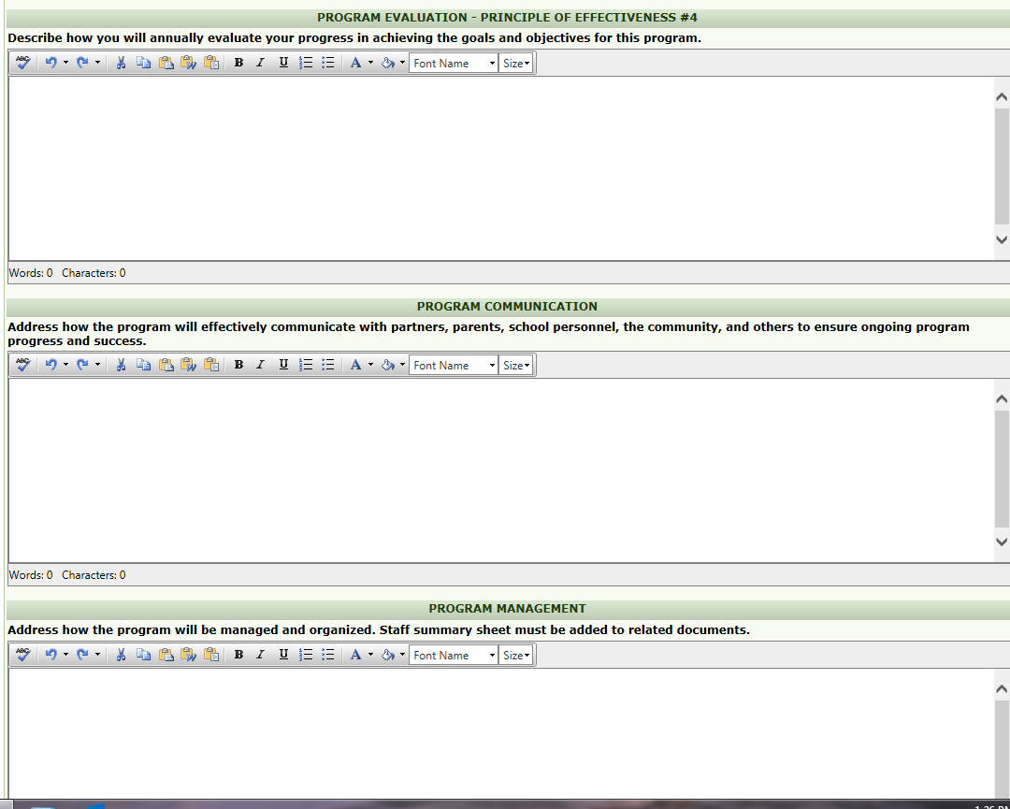
Application Details Continued

Slide 34
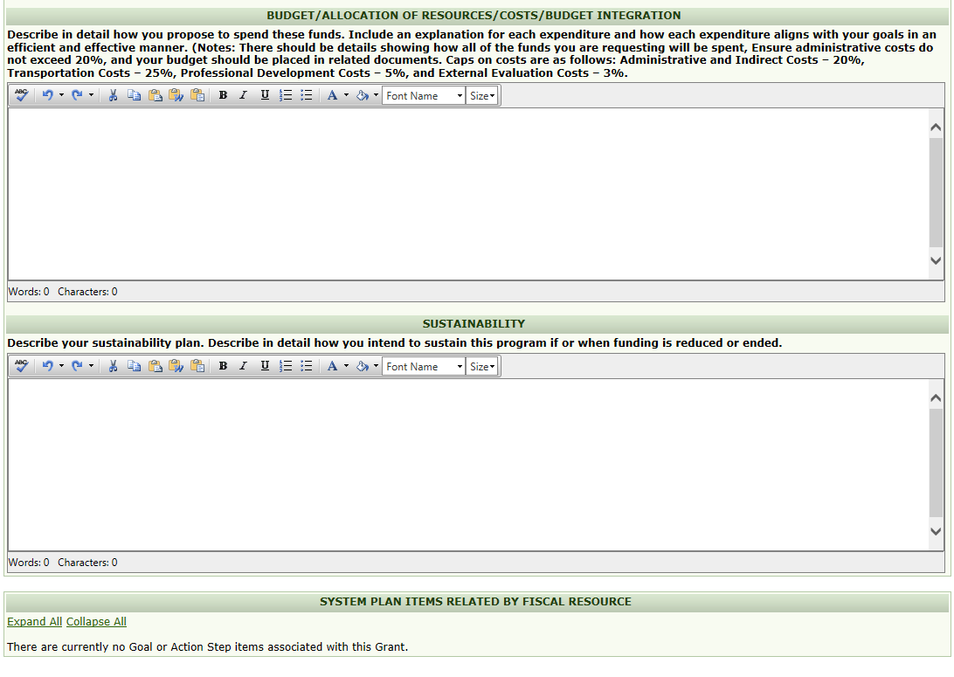
Application Details Continued

Slide 35
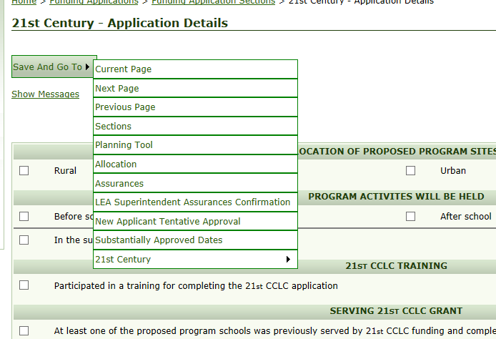
Save and Go

Slide 36
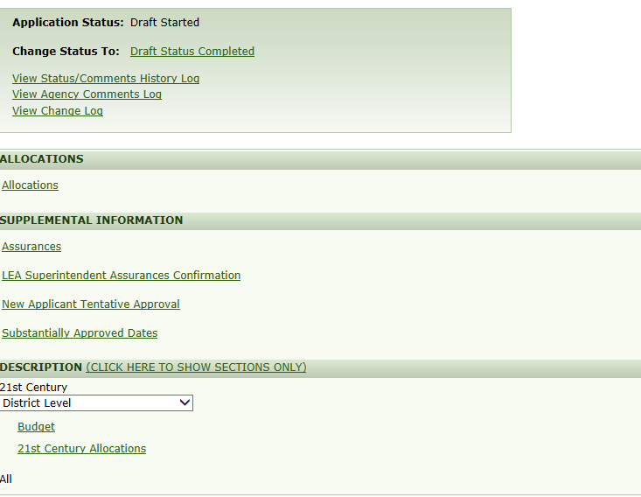
District Budget

Slide 37
District Budget Continued

Slide 38
Save and Go

Slide 39
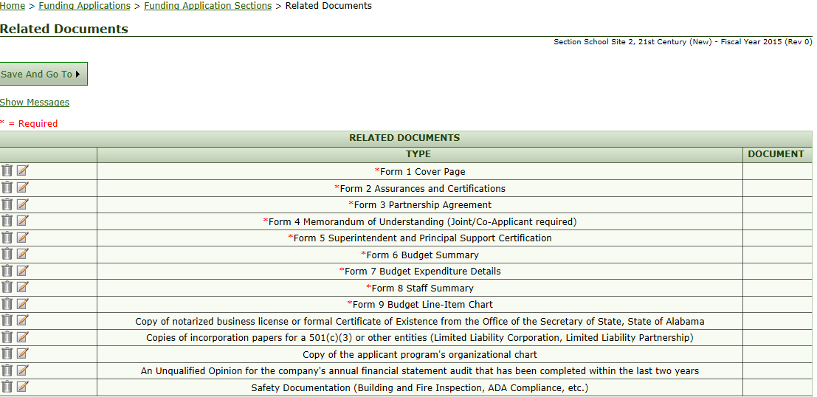
Related Documents
For CBOs only. In these slots,
LEAs will upload a word
Document which says N/A.
If you are applying for multiple sites, please return to the Add Grant Application page, after uploading
these documents, to begin the application for the next site.

Slide 40
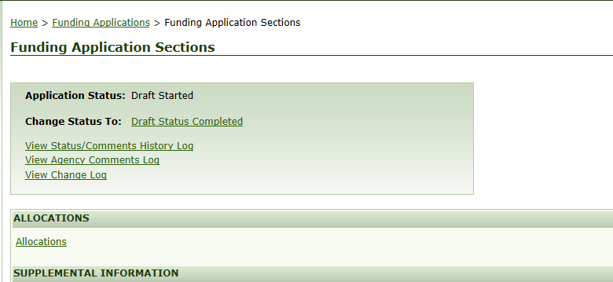
Draft Status Completed
Once you click status complete, you cannot add another grant application.

Slide 41
Approval Chain

Slide 42
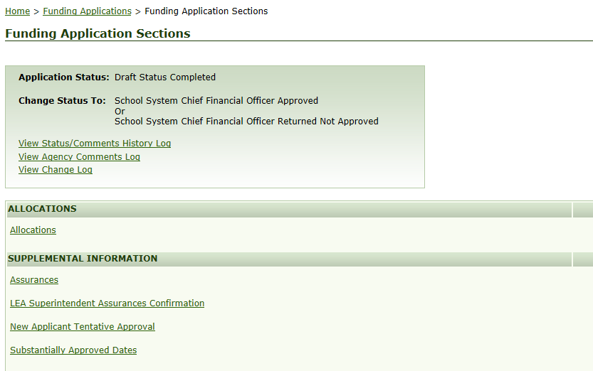
CSFO/Accountant/Authorized Rep Approval

Slide 43
CSFO/Accountant/Authorized Rep Confirmation

Slide 44
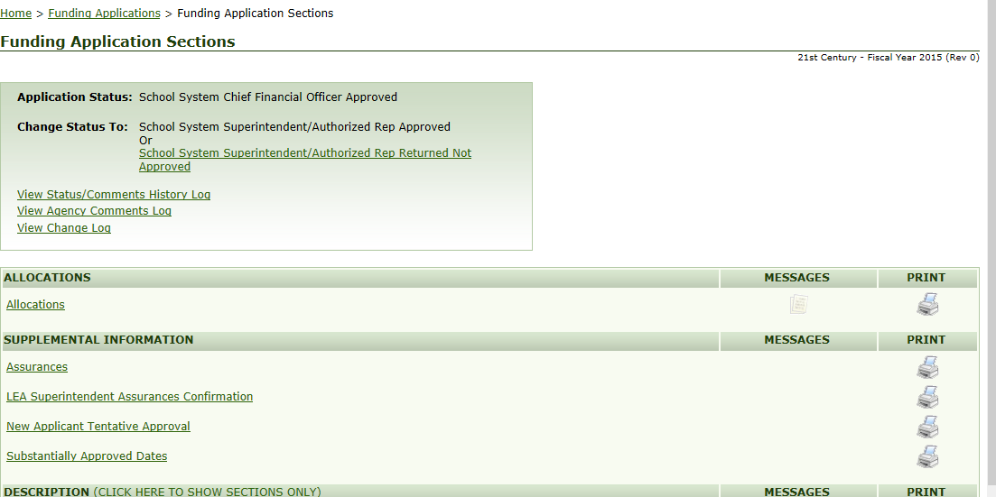
Superintendent/Executive Director/Authorized Representative Assurances

Slide 45
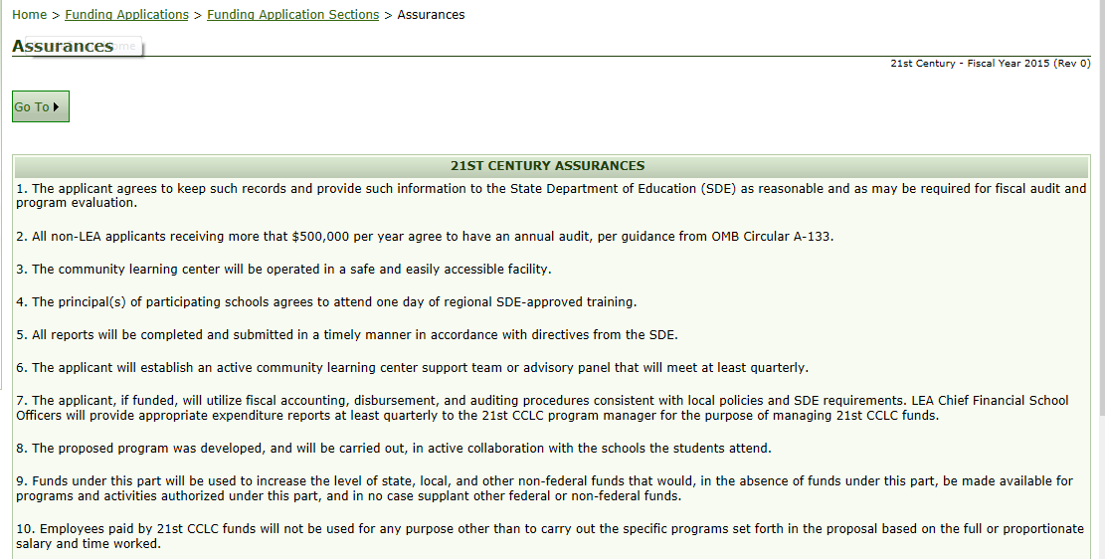
Assurances

Slide 46
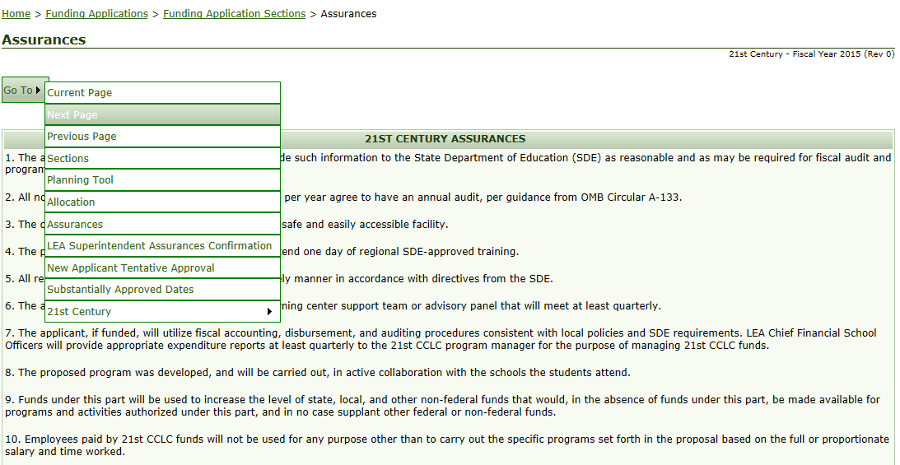

Slide 47
Superintendent/Executive Director/Authorized Representative Assurances

Slide 48
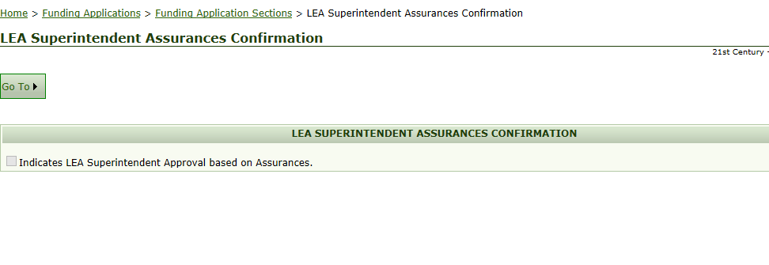
Assurances Confirmation

Slide 49
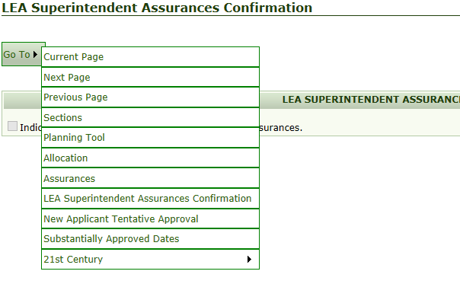
Save and Go

Slide 50
Superintendent/Executive Director Approval
Due by 11:00 p.m. on May 13, 2016

Slide 51
ALSDE Specialist Approval

Slide 52
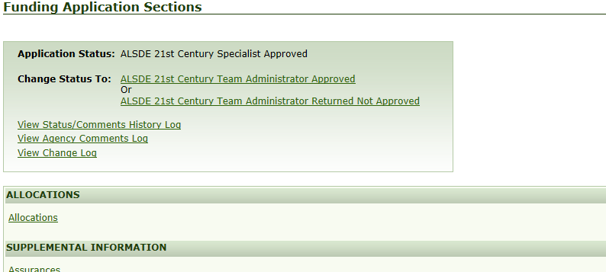
ALSDE Administrator Approval

Slide 53
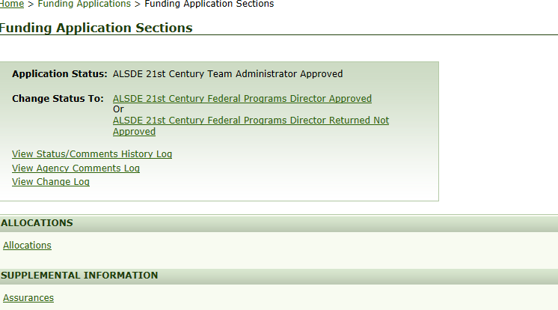
ALSDE Federal Programs Director Approval

Slide 54
21st Century Reviewed

Slide 55
Continuation Grants Cohort 11
LEAs and CBOs who currently have a 21st Century Continuation Grant will not load the continuation grant until directed to do so by the ALSDE. You will receive notification and specific directions as to how to add the continuation grants.

Slide 56
Contact Us!
Mark Ward
mward@alsde.edu
Joslyn Reddick
jreddick@alsde.edu

