Slide 1
Community
Eligibility
Provision

Slide 2
What is the Community Eligibility Provision (CEP)?
  Section 104a of the Healthy, Hunger-Free Kids Act
  Provides an alternative to household applications for free and reduced price meals
  Offers all students free meals in high poverty local educational agencies (LEAs) and schools.

Slide 3
Benefits of CEP
Increases access to school meals for children in high poverty areas
No household applications
Reduces the burden of verification
Compared to other special provisions: no base year

Slide 4
District Participation
31 School Districts participated in 2014-2015
36 School Districts participating in 2015-2016

Slide 5
What is the eligibility threshold for participation in CEP?
Percentage of identified students must be at least 40% of enrollment
Eligibility is determined for an entire LEA, a group of schools within an LEA, or a single school within an LEA

Slide 6
Identified Students
Identified students are defined as the students certified for free meals without the use of a household application.
By definition this includes students directly certified through SNAP, TANF and Foster participation as well as Homeless, Head Start, Pre-K, Even Start, Migrant and Runaway students.
  Identified Students are NOT the same as your Free & Reduced Eligibility numbers.
  Identified Students are NOT those that were certified for free or reduced meals on a Household Eligibility Application

Slide 7
What Do You Need to Know?
If you choose to participate in CEP
  All schools participating in CEP must serve breakfast and lunch to all students at no charge
  All schools participating in CEP will not collect USDA Income Applications
  Any financial loss must be reimbursed using non-federal funds

Slide 8
What is the Multiplier?
Analysis showed that on average for every 10 identified students there were 6 more students certified based on an income application
If you multiply the identified student percentage by 1.6 you are approximating the free and reduced price percentage
Based on USDA regulations, the multiplier can change each year and can fluctuate between 1.6 and 1.3

Slide 9
Multiplier/Reimbursements
The percentage of identified students as of April 1st of the prior year is multiplied by 1.6 to determine the percentage of meals reimbursed at the federal free rate.
The remaining percentage of meals not covered under the provision will be reimbursed at the federal paid rate.
Any meal costs in excess of the total federal reimbursement must be covered through non-federal sources.

Slide 10
CEP Claiming Percentages
Example:
Identified Student % = 50%
Free claiming percentage = 80% (50% X 1.6)
Paid claiming percentage = 20% (100% - 80%)
    Total meals = 1,000
Number of free meals = 800 (1,000 X 80%)
Number of paid meals = 200 (1,000 – 800)
**62.5% Identified Student Percentage (before the multiplier) = 100% Free Claiming Percentage

Slide 11
Intersection Between Title I, Part A and CEP
Within-District Allocations
Accountability
Equitable services to eligible Private school students
Notes:
National school lunch data is often used as an indicator of poverty to carry out Title I programs. Participating in CEP could affect an LEAs poverty data for Title I purposes…
The elements that connect

Slide 12
Determining Poverty Rates
Option 1- For LEAs using Option 1 to determine poverty rates (CEP and non-CEP schools ranking)
  Direct certification in CEP schools
  Free Reduced Paid Lunch (FRPL) application data in non-CEP schools
Option 2-For LEAs using Option 2 to determine poverty rates (CEP and non-CEP schools ranked solely on the basis of the percentage of students directly certified)

Slide 13
Alabama is Using Option 1
For within district allocations, Alabama CEP districts and / or CEP schools will only use Option 1.
Non-CEP schools will continue to use Free Reduced Paid Lunch (FRPL) application data

Slide 14
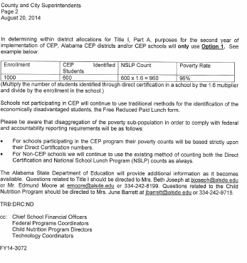
August 24, 2014

Slide 15
Within-district allocation
CEP and Non-CEP schools
Option 1
When LEA has both CEP and Non-CEP schools USE
OPTION 1-Multiply the number of students identified by direct certification in a school by 1.6 multiplier and divide by the school enrollment to derive at the schools poverty percentage in the CEP school
    LEAs continue to collect Free Reduce Paid Lunch (FRPL) Applications in all NON-CEP schools
Notes:
Example:
School A is CEP
School B is non CEP
Use formula in CEP schools ONLY

Slide 16
Within-district allocation
CEP and Non-CEP schools
Option 1
For CEP schools multiply the number of students identified through direct certification in a school by the 1.6 multiplier and divide by the enrollment in the school. Using the multiplier for CEP schools
Enrollment | CEP Identified Students | NSLP Count | Poverty Rate
1000 | 600 | 600 * 1.6 = 960 | 96 percent
Notes:
Option 1 has two parts to it…Use of a combination of data OR use a single source to generate poverty percentages
Now that you have arrived at the poverty percentage….This is the percentage the district should use to rank and serve its schools

Slide 17
eGAP Enhancements for CEP
Enhancements found in 2016 Application
Building Eligibility Page
  “CEP” Column added (check participating schools) or click the “Mark ALL CEP” Button
  The 1.6 Multiplier will automatically be calculated to participating CEP schools and show in the “Recalculation of Low Income X Multiplier Column”
  Low-Income Student Percentage will change with multiplier
  Schools will appear in Rank Order after you SAVE that page
  Able to see the district Poverty Percentage with the Multiplier and Without the Multiplier

Slide 18
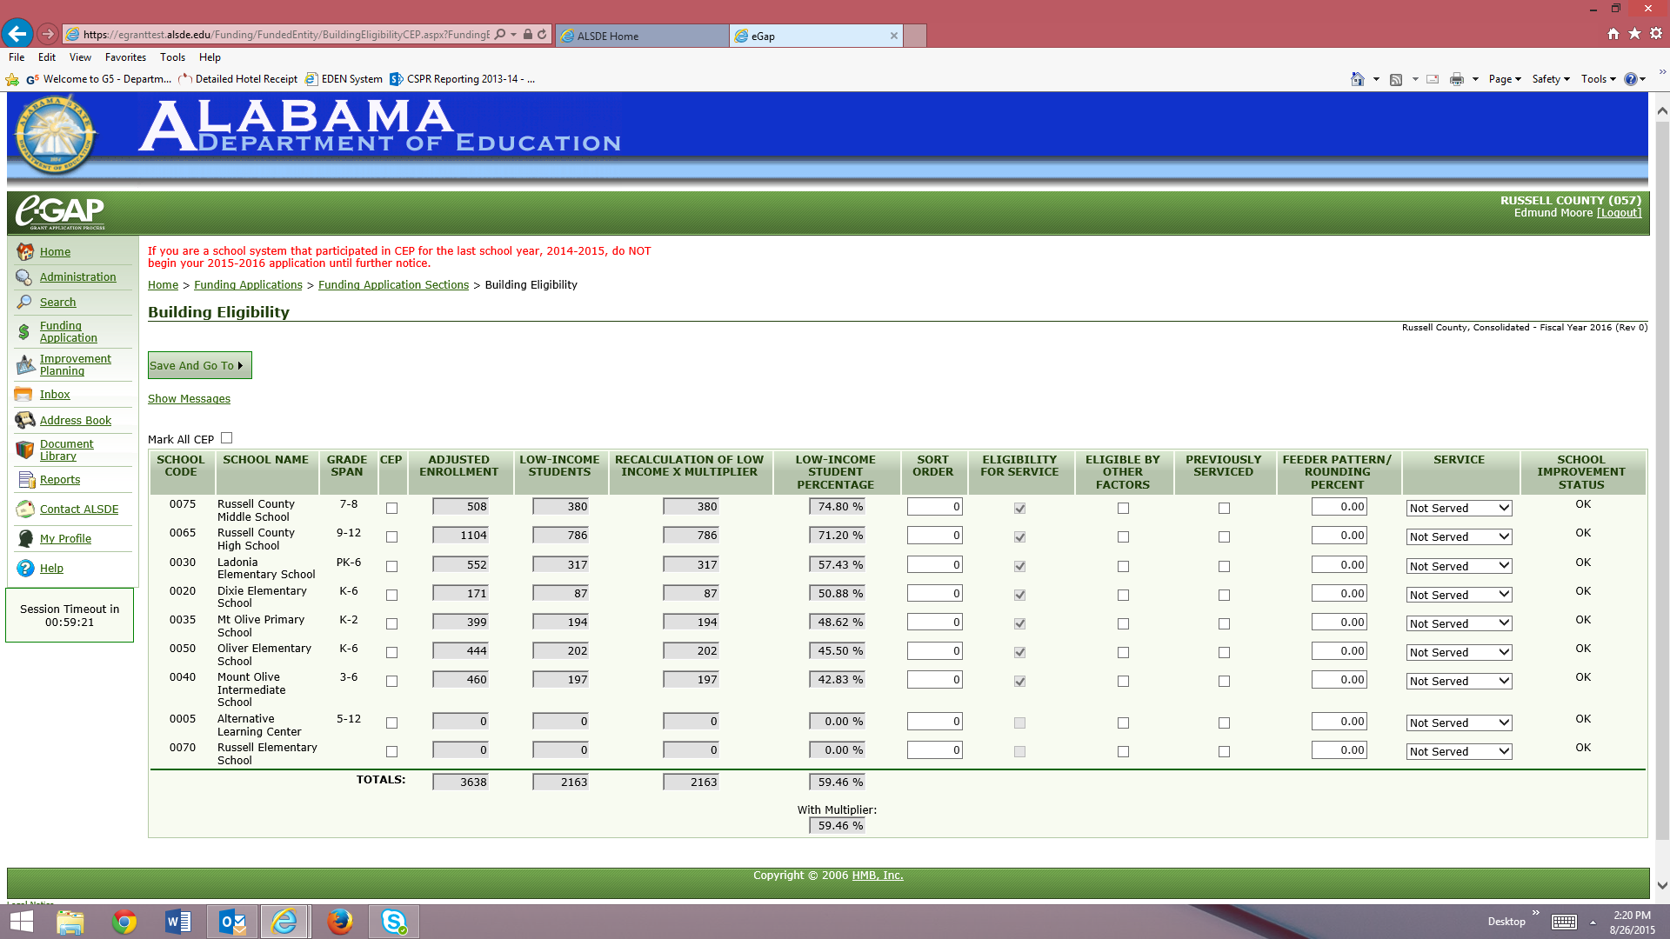

Slide 19


Slide 20
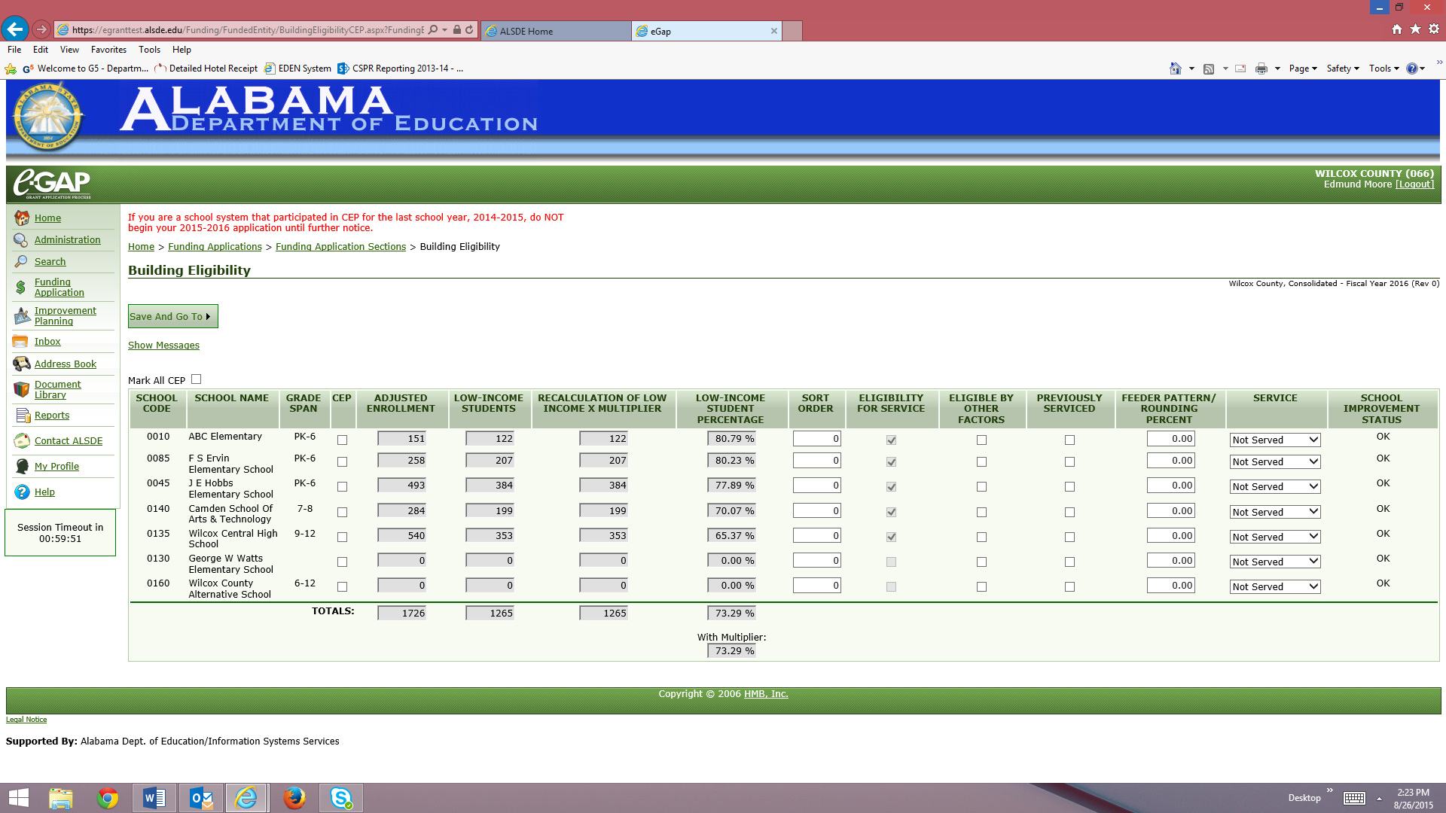

Slide 21


Slide 22
Schools with 100% Poverty
If the application of the 1.6 multiplier results in more than one school at 100% poverty, then use the direct certification (DC) data to differentiate among the schools. (i.e. schools with a higher dc number would rank higher). The DC numbers are found on the building Eligibility Page under the “Low-Income Students” Column.
If two CEP schools are both 100% and have the same direct certification rate, they must be provided the same per-pupil allocation.
As a reminder: Ranking does not apply when there is one school per grade span or straight allocations are being used where all schools receive the same PPA.

Slide 23
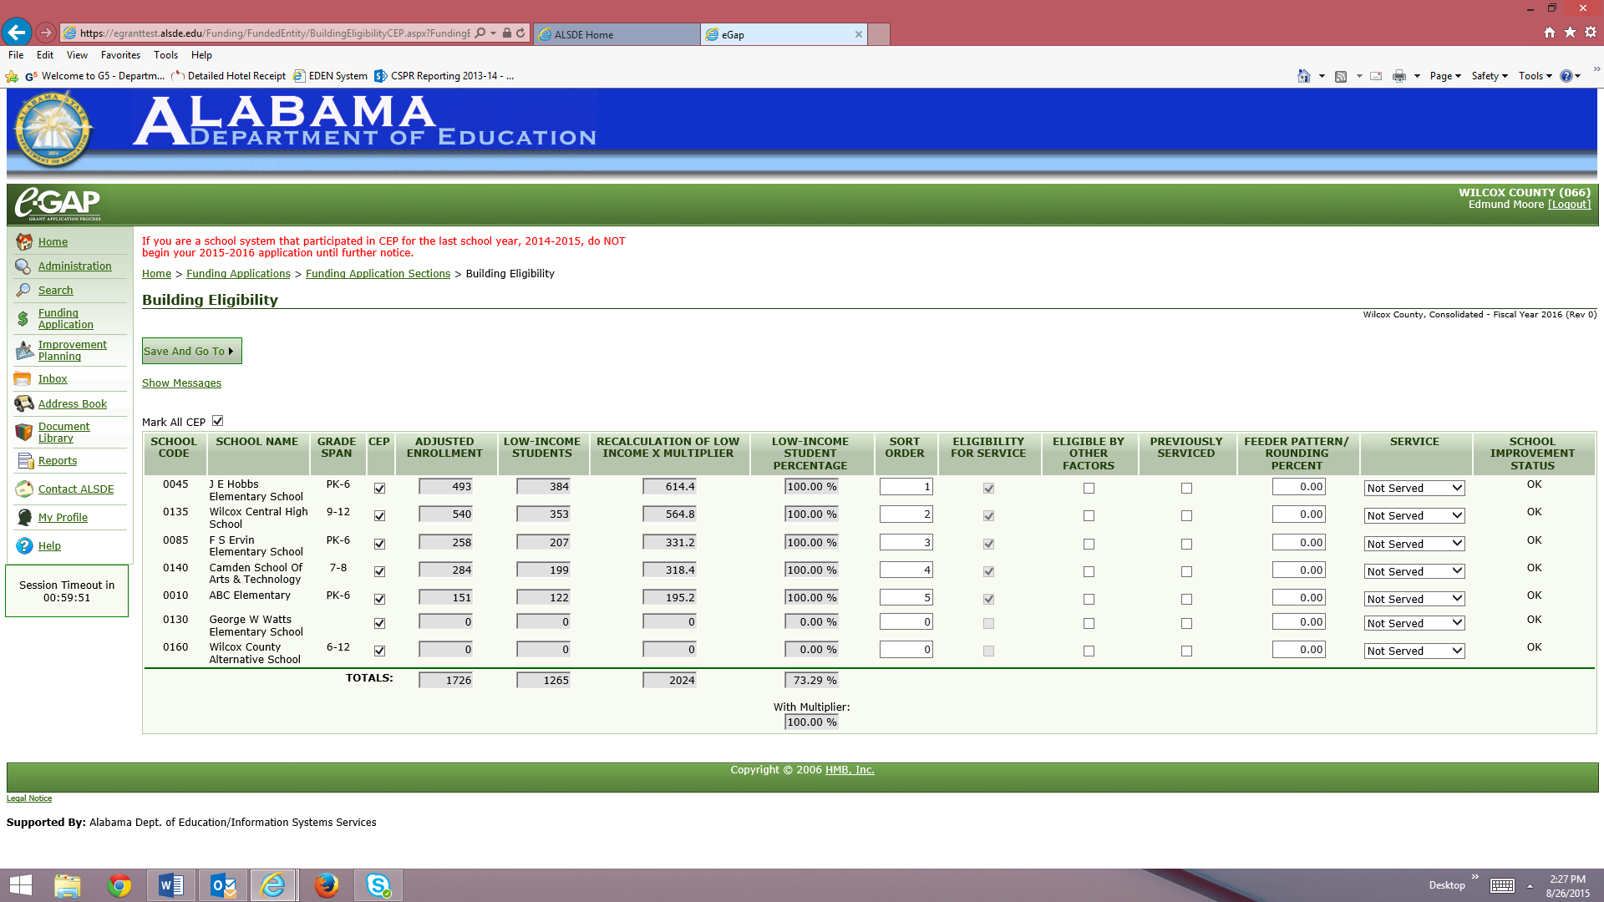

Slide 24
Reminders
As usual, the allocations to schools are based on the low-income student count per the Attendance / Eligibility Guidance. With CEP schools, the low income count is your DC number.
If rankings change, you will need to send a spreadsheet with the new rank orders based on the DC numbers to myself and Leah Johnston:
  bjoseph@alsde.edu
  ljohnston@alsde.edu

Slide 25
Within-district allocations for:
YEAR ONE
Data from Fall Collection for 2014
YEAR TWO
YEAR THREE
(Repeat year two)
YEAR FOUR
(Repeat year two and three)
Option 1
Notes:
CEP schools participating for the first time will have a combination of NSLP data available to it from the prior year. LEAs may use that data to calculate its allocations for TIA.
Example:
23 LEAs participated last year. Allocations were based on the NSLP data from the year before (included FRPL and Direct Certification data).
The first year is the last year an LEA may use a combination of data to determine TIA allocations.
The second year is the first year an LEA will have access to ONLY DC data because FRPL applications were not collected after year one.

Slide 26
Things to Think About
Financial status of each school in your district
Breakfast and Lunch participation
Anticipated level of Federal Reimbursement
Are Non-Federal resources available?
Is school meal application data used to distribute other sources of funding? (Title I, E-rate, Accountability, State, Local, etc.)
How CEP could affect Title I Within District Rankings of schools
Per Pupil Allocations (PPA) in districts that have multiple schools at 100% poverty after the multiplier is used

Slide 27
